Slide 1
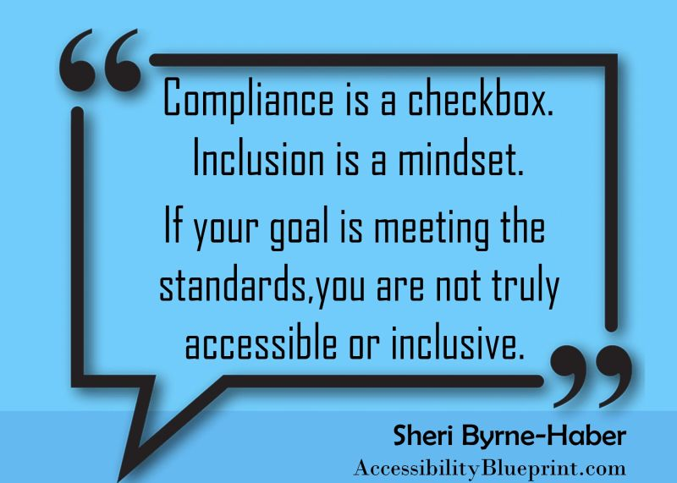
From Compliance to Inclusion
Tracy Leahy ADA and Section 504 Coordinator Office for Civil Rights and Title IX Education and Compliance
Shelby Gombosi Assistant Director Resource Center for Persons with Disabilities Aaron Pena Workplace Accommodations Specialist Employee and Labor Relations

Slide 2
Compliance
Timeline of relevant laws, regulations and court decisions
Milestones and advocates in the disability rights movement
Abuses and indignities people with disabilities expereinced

Slide 3
1800 and 1900’s
1815–1817
Thomas Gallaudet founds the first permanent school for the deaf
1829
Louis Braille invents the raised alphabet
First taught at the St. Louis School for the Blind 30 years later in 1860
1907
Eugenic Sterilization Laws
Indiana first state to enact sterilization law in state institutions. 24 other states follow.
Notes:
Indiana enacted the first eugenic sterilization law in 1907, and the US Supreme Court upheld such laws in 1927. State programs targeted institutionalized, mentally disabled women. Beginning in the late 1930s, proponents rationalized involuntary sterilization as protecting vulnerable women from unwanted pregnancy. By World War II, programs in the United States had sterilized approximately 60,000 persons. After the horrific revelations concerning Nazi eugenics (German Hereditary Health Courts approved at least 400,000 sterilization operations in less than a decade), eugenic sterilization programs in the United States declined rapidly.
In 1927, the U.S. Supreme Court decided, by a vote of 8 to 1, to uphold a state's right to forcibly sterilize a person considered unfit to procreate. The case, known as Buck v. Bell, centered on a young woman named Carrie Buck, whom the state of Virginia had deemed to be "feebleminded.“
All told, as many as 70,000 Americans were forcibly sterilized during the 20th century. The victims of state-mandated sterilization included people like Buck who had been labeled "mentally deficient," as well as those who who were deaf, blind and diseased. Minorities, poor people and "promiscuous" women were often targeted.

Slide 4
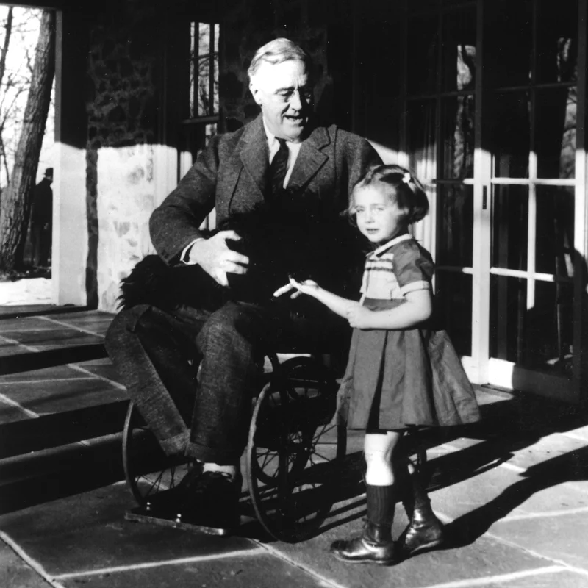
1933 - 1945
Franklin Delano Roosevelt 32nd President of the United States
Notes:
Image of him from 1941 of FDR in a wheelchair holding his dog on his lap and next to the granddaughter of a gardener on his property
The press and the president's aides kept Franklin D. Roosevelt's use of a wheelchair hidden from most of the public during his more than 12 years as the nation's leader.
So hidden, in fact, that an Indiana college professor's discovery of just 8 seconds of film that shows Roosevelt gliding down a ramp aboard the U.S.S. Baltimore in July 1944 is making news in 2013.
"Roosevelt contracted polio in 1921 at age 39 and was unable to walk without leg braces or assistance. During his four terms as president, Roosevelt often used a wheelchair in private, but not for public appearances. News photographers cooperated in concealing Roosevelt's disability, and those who did not found their camera views blocked by Secret Service agents, according to the FDR Presidential Museum and Library's website.“
Early biographies of the president focused on his personal and political life, and treated his disability as just another obstacle overcome on his path to the White House. Two themes emerged among these early retellings of his experience with polio and paralysis—that FDR "conquered" disability, or that his personal struggle with it made him especially attuned to the nation's suffering during the Great Depression. This remained the predominant disability narrative for nearly four decades.
In 1985, a new narrative emerged, portraying FDR as a political figure who hid his paralysis from the American public through acts of deception because, we were told, the public would not knowingly elect a person with a disability. This represented a turning point in how historians and the public understood FDR. No longer omitted or marginalized, disability was understood to be a central and influential experience. However, the deception narrative has remained so entrenched, that a more complete, nuanced understanding of living with disability has been overlooked.
This interaction between body and environment is evident in FDR’s story and at Hyde Park—the ramps and handrails at the Big House (Springwood), the swimming pool at Val-Kill, architectural details and landscape features at Top Cottage, and FDR's customized wheelchairs. Ramps at the White House and U.S. Capitol, modified automobiles, architectural innovations at Warm Springs, and even the train car and airplane used by the president, all illustrate how FDR created an environment to mitigate the effects of a world that was not designed for people with disabilities.

Slide 5
1930's and 1940's
1934 – 1940 - National Federation of the Blind founded
1935 – Social Security Act – FDR signs into law establishing program for permanent assistance for adults with disabilities
1939 – 1941 - Nazi's order "mercy killings" of 75,000 – 250,000 people with intellectual and physical disabilities
1946 – National Mental Health Foundation
1946 - Paralyzed Veterans of America founded
Notes:
In the early 1940s National Mental Health Foundation originated in 1944-1945 when Harold Barton and three associates, serving at Byberry State Hospital in Philadelphia (Pennsylvania), announced plans for a national campaign to improve the conditions in mental hospitals. The exposure of these conditions through the efforts of men serving in CPS, and their efforts to be a nonviolent presence in mental institutions, began a new movement in mental health care in the U.S.
he hospital was turned over to the state in 1936 and was renamed the Philadelphia State Hospital at Byberry. Conditions in the hospital during this time were poor, with allegations of patient abuse and inhumane treatment frequently made. The situation came to national attention between 1945 and 1946, when conscientious objector Charlie Lord took covert photos of the institution and the conditions inside, while serving there as an orderly.[1]
The 36 black-and-white photos documented issues including dozens of naked men huddling together and human excrement lining facility hallways. The photos were shown to a number of people, including then-First Lady Eleanor Roosevelt, who subsequently pledged her support in pursuing national mental health reforms. In May 1946, Lord's photos were published in an issue of Life, creating a national "mass uproar".[1]
In his 1948 book, The Shame of the States, Albert Deutsch described the horrid conditions he observed:
"As I passed through some of Byberry's wards, I was reminded of the pictures of the Nazi concentration camps. I entered a building swarming with naked humans herded like cattle and treated with less concern, pervaded by a fetid odor so heavy, so nauseating, that the stench seemed to have almost a physical existence of its own."
During the 1960s, the hospital began a continuous downsizing that would end with its closure. During the mid-1980s, the hospital came under scrutiny when it was learned that violent criminals were being kept on the hospital's Forensic Ward (N8-2A). In 1985, the hospital failed a state inspection, and was accused of misleading the inspection team.
Reports of patient abuse were still rampant through the 1980s. One patient had reported that one of his teeth was pulled without "Novocaine".[citation needed] Another state inspection team was sent to evaluate the hospital in early 1987. By the summer of 1987, five of the Philadelphia State Hospital's top officials were promptly fired after the Byberry facility once again failed the state inspection.
PVA was founded by a band of service members who came home from World War II with spinal cord injuries. These wounded heroes made a decision not just to live, but to live with dignity as contributors to society.
Since 1946, Paralyzed Veterans of America has been on a mission to change lives and build brighter futures for our seriously injured heroes. We’ve had a single-minded mission—to empower our brave men and women to regain what they fought for: their freedom and independence.
World War II – September 1, 1939 to September 2, 1945

Slide 6
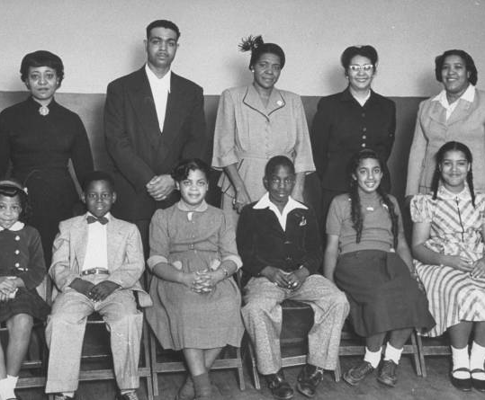
1954
Brown v Board of Education
Notes:
Why is Brown v Board of Education an important milestone in the disability rights movement? Holding in Brown, separate educational facilities are inherently unequal.
The 1954 Brown v. Board of Education ruling laid the foundation for the 1975 federal law (now called the Individuals with Disabilities Education Act) requiring access to a free appropriate public education for all children with disabilities. Before 1975, about one million American children with disabilities were receiving no education from the public school system. Since then, we have made progress in securing quality, integrated educational opportunities for American children with disabilities, but we still have a long way to go – particularly for children with intellectual disabilities.
There is a history of people with intellectual and developmental disabilities learning, living and working in separate settings. As the Court noted in Brown, “Separate educational facilities are inherently unequal.” That statement was a stimulus for a civil rights movement that sought to integrate people with disabilities into every aspect of society. In the 1960s it was rare to find any public school that integrated students with intellectual disabilities. Although progress has been made, we still find widespread segregation of these students. Fifty-six percent of students (ages 6-21) with intellectual disabilities are primarily educated in separate classes or separate schools (United States Department of Education. 31st Annual Report to Congress on the Implementation of IDEA, 2009). The effects of segregation are significant. Twenty-seven percent of people with intellectual disabilities (aged 21-64) do not have a high school diploma (American Community Survey, 2012). The curriculum offered in segregated settings is often vastly different than the curriculum offered in typical classrooms (Wehmeyer, 2003). Students in segregated classrooms are less engaged and spend more time alone (Hunt, Farron-Davis, Beckstead, Curtis, & Goetz, 1994).

Slide 7
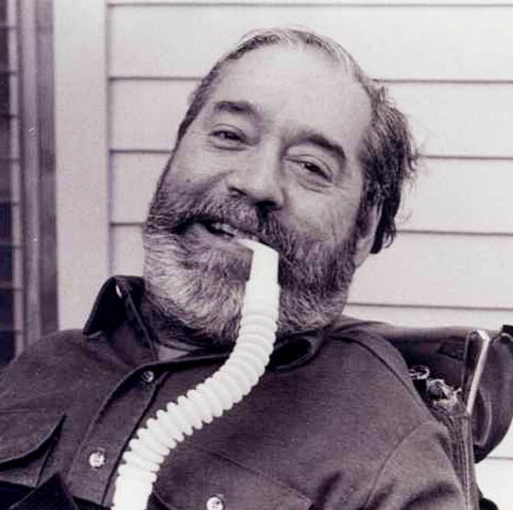
Ed Roberts
1962 – Ed Roberts enrolls at the University of California Berkley
Notes:
Edward (Ed) Verne Roberts is considered the father of the independent living movement. As a hero in the United States’ disability rights movement, Roberts paved the way for people with physical disabilities to access higher education.
Roberts was born in San Mateo in 1939. When he was fourteen, he contracted polio and had to pause his high school studies. After surviving polio, Roberts was left paralyzed in most of his lower body except for several of his fingers. As he recovered, Roberts needed an iron lung or respirator. Because of this medical equipment, Roberts attended his classes by listening in on the telephone. He spent eighteen months receiving treatment until he returned home.
After returning to his school in person, Roberts realized that many students with disabilities (like himself) faced discrimination. His school refused to allow him to graduate because he was unable to complete the driver’s education and physical education credits. Nonetheless, Roberts successfully petitioned his school to grant him his diploma. His uncertain graduation was only the first of such challenges that Roberts would encounter in school.
Upon graduating from high school, Roberts was accepted to the University of California, Berkeley.[1] Unfortunately, administrators tried to reverse Roberts’ acceptance when they realized that he was quadriplegic. Representatives of the school claimed that the dorms on campus did not have the appropriate equipment or space to accommodate Roberts’ 800-pound iron lung and his wheelchair. Roberts insisted on enrolling in classes, though, and he became the first student at his university to use a wheelchair.
As an undergraduate student, Roberts created a group called the Rolling Quads. This group of students with disabilities moved into a dorm together. As a club, they pressured UC Berkeley to design more accessible classroom and dorm buildings for students with disabilities. This group grew into the Physically Disabled Students Program, which was the country’s first college organization for students with disabilities.
The Physically Disabled Students Program would inspire Roberts to create a community in Berkeley where people with physical disabilities could live as independently as possible. Founded in 1972, this community was the first Center for Independent Living. It served as a model encouraging the movement toward independent living and accessibility in the disabled community.
In 1964, Roberts earned his BA, and he received his MA two years later. While he was accepted as a Ph.D. student, he never completed his degree; however, he taught political science courses at UC Berkeley for six years. Roberts later directed California’s Department of Rehabilitation. In 1980 Roberts, alongside fellow activist Judy Heumann, co-founded the World Institute on Disability, a program that continues to educate students about disability. Since his death, the state of California has memorialized Ed Roberts with a holiday in his honor. Every January 23rd is Ed Roberts Day.

Slide 8
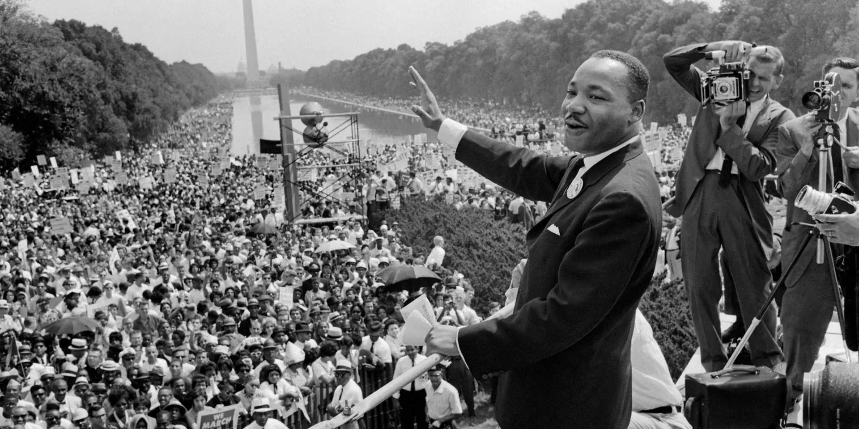
Civil Rights Act of 1964
1964 – Civil Rights Act is passed
Prohibits discrimination based on race, sex, national origin and color
Bypasses people with disabilities

Slide 9
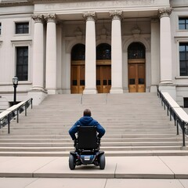
1960’s
1963 – Community Mental Health Act signed into law by John F. Kennedy
1965 – Medicaid assistance for people with disabilities and low income
1968 – Architectural Barriers Act of 1968
First measure by Congress to ensure access to the built environment for people with disabilities. The law requires that buildings or facilities that were designed, built, or altered with federal dollars or leased by federal agencies after August 12, 1968 be accessible.

Slide 10
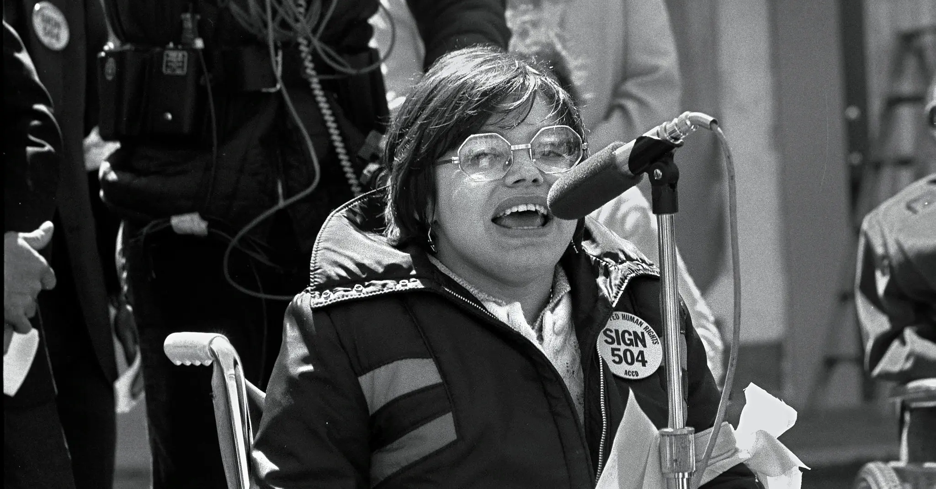
Judy Heumann
1970 - Judy Heumann sues NYC Board of Education after being denied a teaching license because her wheelchair is a "fire hazard“
1977 – Occupation of the Federal Office of Health, Education and Welfare in San Francisco

Slide 11
Brad Lomex
Brad Lomex
Black panther leader and organizer
Arranged for the strategic logistical support of the Oakland Black Panthers at the 504 Sit-In
Notes:
Intersectionality in our own political and social movements. Larned organizing and civil disobedience tactics from race, sex, and national origin movements that preceded disability movement. The critical 504 Sit-In was diverse as to race, national origin, sex, sexual-orientation and religious faiths of the leadership and participants, and kinds of disability. Directly supported by the Black Panthers, the Butterfly Brigade, Cesar Chavez and more.
Brad Lomax, Howard University graduate, Washington D.C. Black Panthers leader and organizer with MS, center of picture. Next to Lomax is Judy Heumann at a rally in 1977 at Lafayette Square. Subsequently they were colleagues at the 504 Sit-In in San Francisco and its conclusion in Washington DC. Lomax arranged for the strategic logistical support of the Oakland Black Panthers at the 504 Sit-In. Credit...HolLynnD'Lil

Slide 12
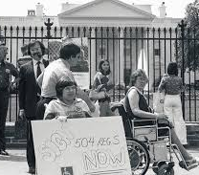
Section 504 of the Rehabilitation Act
Section 504 states that “no qualified individual with a disability in the United States shall be excluded from, denied the benefits of, or be subjected to discrimination under” any program or activity that either receives Federal financial assistance or is conducted by any Executive agency or the United States Postal Service.
Section 504 created and extended civil rights to people with disabilities. Section 504 has also provided opportunities for children and adults with disabilities in education, employment, and various other settings. It even allows for reasonable accommodations such as special study area and assistance as necessary for each student.
Regulations applicable to higher education have not been revised since issued 51 years ago

Slide 13
1970's
1971
PARC v. Commonwealth of Penn
1973
Disabled in Action – Philadelphia disability advocacy group – "Nothing About Us Without Us"
1974
Remaining "Ugly Laws" repealed
1975
Education for Handicapped Children Act of 1975 signed into law – now known as Individuals with Disabilities Education Act (IDEA) - Guarantees a free, appropriate, public education for all children with disabilities
Notes:
Nothing about us without us - The phrase is used to promote the full participation of people with disabilities in the planning and development of policies and strategies that affect their lives.
The "Ugly Laws" were a series of laws passed in the United States from the 1860s to the 1970s that made it illegal for people with visible disabilities to appear in public. These laws were intended to keep people with disabilities, injuries, or destitution off the streets and out of sight. he Chicago ordinance of 1881 read as follows:
Any person who is diseased, maimed, mutilated, or in any way deformed, so as to be an unsightly or disgusting object, or an improper person to be allowed in or on the streets, highways, thoroughfares, or public places in the city, shall not therein or thereon expose himself or herself to public view, under the penalty of a fine of $1 for each offense (Chicago City Code 1881).
Penn Association Case - PARC v. Pennsylvania was one of the first cases to establish that people born with an intellectual disability should have the same access to education as the rest of the population.

Slide 14
July 5 and 6, 1978 - We Will Ride!" Protests - Denver, Colorado
Notes:
On July 5 and 6 in 1978, a group of 19 individuals from the Atlantis/ADAPT Community blocked the busy intersection of Broadway and Colfax in downtown Denver in a protest against the lack of wheelchair accessibility for RTD buses. The group of disability activists, who became known as the “Gang of 19,” blocked traffic and chanted “We will ride!” until the city and RTD agreed to make the buses accessible to people who use wheelchairs.
Today, a plaque at Broadway and Colfax commemorates the activist’ efforts

Slide 15
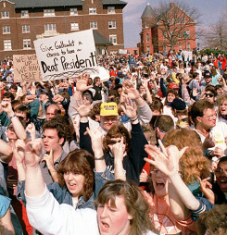
1980's
1982 – Speaking for Ourselves is founded
1982 – National Organization on Disability founded
1988 – Deaf President Now! Gallaudet University student protests leading to the naming of Dr. I. King Jordan as the first deaf and hard of hearing president of the university

Slide 16
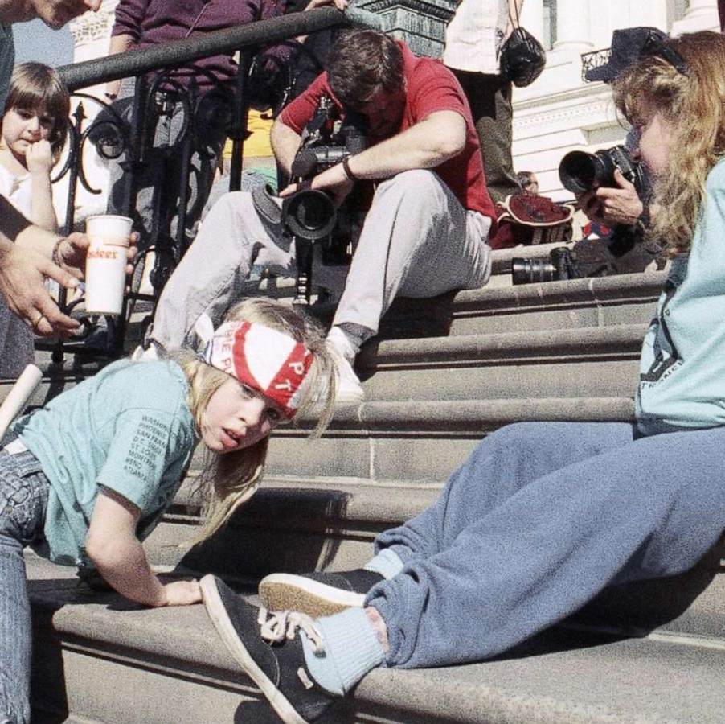
1990’s
March 12, 1990 – Capitol Crawl Protest
Notes:
Jennifer Keelan-Chaffins is the young girl in the Capitol Crawl photo. At age eight, she was the youngest person to climb the steps of the US Capitol Building during the Capitol Crawl on March 12, 1990. The photo of her became a symbol of the disability rights movement's efforts to pass the Americans with Disabilities Act (ADA). The demonstration thus played a significant role in swaying Congress to pass the ADA, which brought about substantial transformation for disability rights across the United States.
Jennifer Keelan-Chaffins was born in Michigan in 1981. Born a month prematurely and weighing only three pounds and ten ounces, at the age of two she was diagnosed with cerebral palsy, which left lesions within the motor cortex of her brain. Her mother Cynthia and grandfather Chuck were told by doctors that Jennifer would never be able to move, talk, or learn, and they recommended that she be placed in a home or be put up for adoption. However, Jennifer’s family opted to raise her at home, and their experience gave them the motivation to become actively involved in the disability rights movement. Cynthia recalled, “When she was born, she had her fist clenched in the air. We just let her do the rest… She was a very strong advocate.”
During her formative years, Jennifer experienced significant discrimination due to her disability: She was “forced to take separate classes (irregardless of her aptitude and ability), impeded by the sheer lack of accessible buildings and transit and shunned by her peers.” However, these experiences only galvanized Jennifer’s fighting spirit, leading her to participate in her first disability rights protest in Phoenix, Arizona, at the age of six in support of the disability rights group ADAPT and its demands for greater accessibility. This protest made a profound impression on Jennifer, who reflected that “it was pretty cool [to see] a bunch of people in wheelchairs fighting for their rights.” Shortly afterward, Jennifer had her first experience with blatant discrimination when she and other ADAPT members were denied service at a restaurant, where the staff told them, “People don’t want to watch you all eat.”
Following her participation in the Phoenix protest, Jennifer and her mother became active organizers in the disability rights movement and continued to join protests around the U.S. and Canada. At the age of seven, she and her mother were arrested during a protest in Montreal, Canada, together with other activists during a peaceful disability rights demonstration, a moment which shocked North America. In March 1990, they took part in the Washington, D.C. protest focused on demanding passage of the ADA. When disability rights activists began their historic “Capitol Crawl,” some organizers didn’t think it was a good idea for Jennifer to participate, fearing that the image of a disabled child crawling up the Capitol steps, Jennifer reflected, “would send a message of pity instead of empowerment.” However, Jennifer was determined to take part in the crawl, telling them that “if somebody my age didn’t do it, then nobody from my generation would be represented.” Jennifer recalled that while the day was very hot and the crowd had grown very large, the “further up the steps I went, the more I felt empowered. I felt like I had all of the other kids behind me [who couldn’t be there]. I felt that it was important, not just to represent myself, but to represent them and their voices.”
The Capitol Crawl had a dramatic impact on the Congressional debate over passage of the ADA since it forced members of Congress to see firsthand the physical barriers that members of the disability community confronted, and consequently the protest helped to push the stalled bill out of committee, leading to its signing into law by President George H.W. Bush on July 26, 1990. Jennifer’s participation in the Capitol Crawl undoubtedly had a powerful influence since the iconic footage taken of her on the Capitol steps transformed her into an icon for the disability rights movement. The ADA’s implementation had a sweeping and far-reaching impact on disability rights, placing requirements for accessibility in public facilities in the form of automatic doors, bathroom stalls with grab bars, and Braille on elevator buttons; closed captioning services for television and telecommunications; opportunities for institutionalized individuals with disabilities to live independently; and the integration of school classrooms, which had a transformative effect on how children viewed their peers with disabilities. Furthermore, the ADA became a global model for disability rights laws around the world; “since 2000, 181 countries have passed disability civil rights laws inspired by the ADA.”
In the years following the Capitol Crawl protest, Jennifer Keelan-Chaffins has remained an active disability advocate. Together with her mother, she fought valiantly “for her right to an education, her dignity and privacy, and her fundamental civil rights.” Jennifer’s advocacy for her education ultimately proved successful, as she graduated in 2017 with a Bachelor of Science in Family and Human Development. She has since founded Jennifer Keelan-Chaffins LLC to continue her activism and has worked with BraunAbility, a manufacturer of accessible vehicles, to design a modified van that she can drive independently. In addition, Jennifer engages on two major fronts today in the battle for quality: education around disability and accessibility, and political activism to effect change. In the educational field, she teaches children across the U.S. “about what it means to live with a disability, the importance of accessibility, and becoming advocates for themselves and for their family and friends with a disability.” Furthermore, she works with businesses and corporate organizations to better understand the ADA and its role in ensuring the right of people with disabilities to education, employment, and access.
Today, Jennifer lives with her mother and her service dog Mya in Denver, Colorado. She has authored the book All The Way to the Top, an illustrated children’s book chronicling the story of her participation in the Capitol Crawl, to “show young readers that they can make a difference on the issues they [care] about, no matter their age.” She hopes that her example will inspire children and their parents and teachers to learn more about the disability rights movement, which most people know relatively little about today but has had a highly influential impact on American society. Jennifer maintains, “For me, the disabilities rights movement is just [as] important as the civil rights movement, and these are things that need to be taught

Slide 17
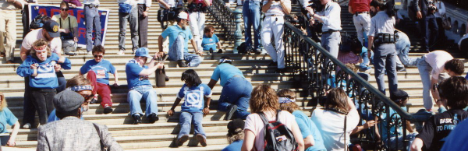
July 26, 1990 – Americans with Disabilities Act
The ADA prohibits discrimination on the basis of disability in employment, State and local government, public accommodations, commercial facilities, transportation, and telecommunications. It also applies to the United States Congress.
Title I – Employment
Title II – State and Local Governments and public transportation
Title III – Public accommodations
Title IV – Telecommunication and Relay services
Title V – Miscellaneous provisions - state immunity, its impact on insurance providers and benefits, prohibition against retaliation and coercion, illegal use of drugs, and attorney’s fees. This title also provides a list of certain conditions that are not to be considered as disabilities.

Slide 18
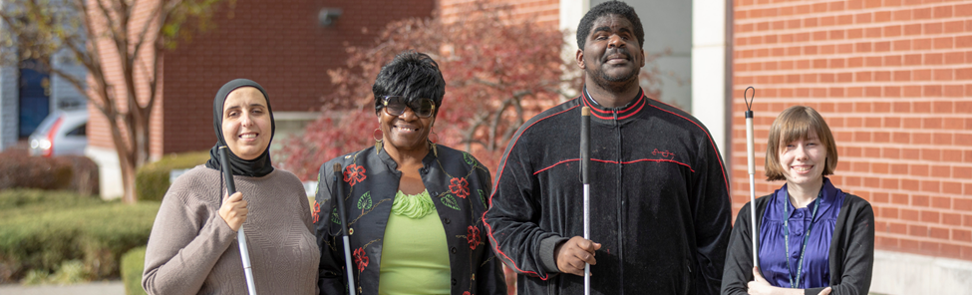
1990's
1990 – IDEA enacted
1991 – Autism is identified as a special education category by the federal government and public schools begin offering children with autism services
1993 – National Home of Your Own Alliance founded
1995 – National Federation of the Blind establishes dial-up synthetic-speech talking newspaper
1996 – Federal Telecommunications Act – requires computers, telephones, closed captioning and other telecommunications devices and equipment be made accessible
1988 – Assistive Technology Act – promotes awareness of and access to assistive technology devises and services
1999 – Olmstead v LC and EW – The ruling requires states to eliminate unnecessary segregation of people with disabilities and to ensure that they receive services in the most integrated setting appropriate to their needs.
Notes:
The National Home of Your Own Alliance, established in 1993 at the University of New Hampshire’s Institute on Disability, is a national technical assistance center and clearinghouse that focuses on homeownership and control for people with disabilities. The Alliance was created by a five-year cooperative agreement with the United States Department of Health and Human Services Administration on Developmental Disabilities. Twenty-three states receive ongoing support from the Alliance to develop pilot projects of homeownership.
Until 1995 the nation's blind people did not have the promise of ready access to a fundamental source of such information--the daily newspaper. But now the National Federation of the Blind has created Newsline, a new system for transmitting the information in newspapers and other sources to blind persons at the same time it is available to sighted readers.
* How Does Newsline Work?
The NFB has designed this revolutionary system to receive digital transmissions from newspapers on the morning of publication, convert this information into computer-generated synthetic speech, and transmit the information to a Local Service Center (LSC) which blind persons can call on touch tone phones.
AT devices can be “low tech,” “medium tech,” or “high tech”–as the examples below show.
power and manual wheelchairs, scooters, canes, walkers, and standing devices
augmentative communication devices (speech generating devices), voice amplifiers and speech recognition devices
durable medical equipment and medical supplies, such as patient lifts and incontinence supplies
orthotics and prosthetics, such as hearing aids and electric larynxes
accessibility adaptations to the home, workplace, schools, group homes, nursing facilities, ICF/MRs, and other places (e.g., ramps, stair glides, lifts, grab bars, flashing smoke detectors, lever doorknobs, and environmental controls)
special equipment to help people work, study, and engage in recreation, such as enlarged computer keyboards, reachers, amplified telephones, magnifiers, voice recognition software, and adaptive sports equipment
accessibility modifications in the community, such as audio systems on public transportation, talking ATMs, and voting machines for the blind (Disability Rights Network of Pennsylvania, 2008)
The story of the Olmstead case begins with two women, Lois Curtis and Elaine Wilson, who had mental illness and developmental disabilities, and were voluntarily admitted to the psychiatric unit in the State-run Georgia Regional Hospital. Following the women's medical treatment there, mental health professionals stated that each was ready to move to a community-based program. However, the women remained confined in the institution, each for several years after the initial treatment was concluded. They filed suit under the Americans with Disabilities Act (ADA) for release from the hospital.
The Decision
On June 22, 1999, the United States Supreme Court held in Olmstead v. L.C. that unjustified segregation of persons with disabilities constitutes discrimination in violation of title II of the Americans with Disabilities Act. The Court held that public entities must provide community-based services to persons with disabilities when (1) such services are appropriate; (2) the affected persons do not oppose community-based treatment; and (3) community-based services can be reasonably accommodated, taking into account the resources available to the public entity and the needs of others who are receiving disability services from the entity.
The Supreme Court explained that its holding "reflects two evident judgments." First, "institutional placement of persons who can handle and benefit from community settings perpetuates unwarranted assumptions that persons so isolated are incapable of or unworthy of participating in community life." Second, "confinement in an institution severely diminishes the everyday life activities of individuals, including family relations, social contacts, work options, economic independence, educational advancement, and cultural enrichment."

Slide 19
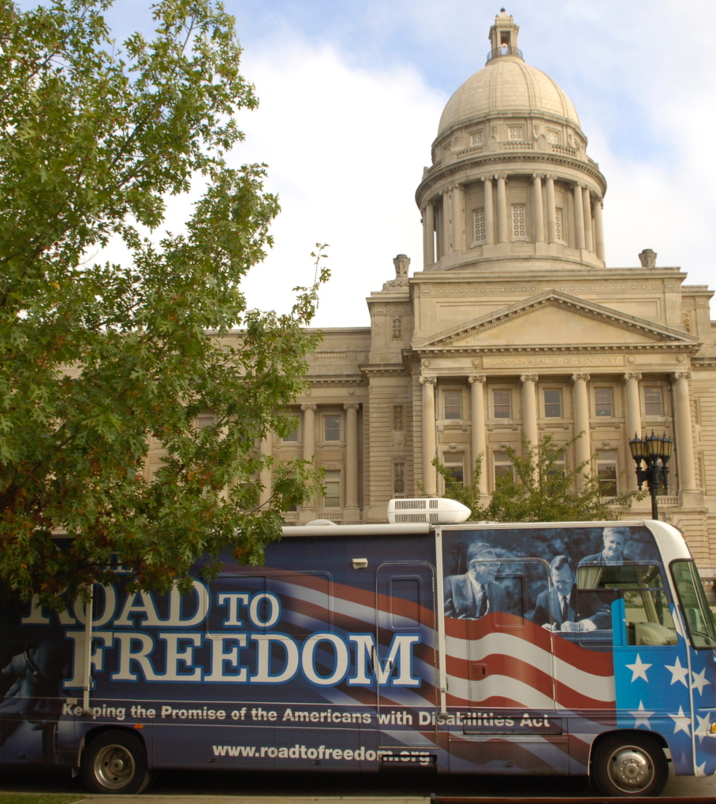
2000's
2001 – The Commonwealth of Virginia expresses regret for the involuntary sterilization of 8,000 people between 1924 and 1979
2004 – First Disability Pride Parade in Chicago - "Change the way people think about and define disability, to break down and end the internalized shame among people with disabilities, and to promote the belief in society that disability is a natural and beautiful part of life."
2007 – Road-To-Freedom Tour – bus and photographic exhibit chronicling the history of the grassroots movement that led to the passing of the ADA

Slide 20
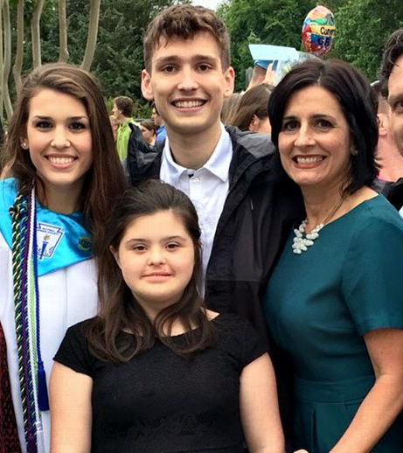
2000's
2008
West Virginia requires disability history to be taught in K-12 public schools
2009
Rosa's Law enacted – replacing the term "mental retardation" with the term "intellectual disability." Signed by Barack Obama.
2012
Philadelphia Disability Pride Celebration
Notes:
Rosa Marcellino a young advocate with Down Syndrome
Rosa makes an exception on this day because, well, she's a pro at this media stuff. She has been doing it for more than five years, ever since she became the adorable face of the movement to erase the term "mentally retarded" from government lexicons. With a little help from her family, the brown-haired kid succeeded in removing the "R-word" from official government documents in her home state and in federal bureaucracy. The historic legislation is known as "Rosa's Law," part of a 30-year wave of activism that has changed how we speak about people who have difficulties in learning and cognition.
"The most recent change from 'mental retardation' to 'intellectual disability' was unique in that much of the impetus came from people with intellectual disability and their families," wrote Marty Ford, Annie Acosta and T.J. Sutcliffe in an April 2013 article in "Intellectual and Developmental Disabilities," a scholarly journal. "This impetus grew in the public realm and played out in open debates in the organizations devoted to their interests, in the halls of state legislatures and Congress, resulting in terminology changes in federal law through Rosa's Law."
Rosa's Law went from notion to national statute in a little more than two years, capped in October of 2010 when President Obama signed it at the White House. "We went to the White House together," Rosa says matter-of-factly, "and he is president, and he is handsome to me. And so we went to his house to [see] my law be signed. And I got a big hug."
Did she just say the commander-in-chief was handsome? "Yes," she says, cracking up.
Rosa is a teenager, so she notices those things. She reveals that one of her teammates on her Special Olympics 4x100 meter relay is also "handsome," as well as the fastest runner she has seen in her life.
Rosa is swift, too. She has a new gold medal in her favorite Special Olympics event, the 100 meters, to prove it. "I'm fast at the beginning, and at the end," she says. Her gold medal in the 100 and relay races were part of a busy day at a Maryland Special Olympics meet in June, which also saw her compete in the 50 meters and the softball throw. She did all this despite coming off surgery to repair kneecap and ligament problems resulting from Down syndrome. Rosa is a gamer.
So is her family. Sports are "huge" for the Marcellinos, says Rosa's 20-year-old brother Nick, the oldest of Nina and Paul's four children, and a junior engineering major at North Carolina State. All of Rosa's siblings -- Nick, Madeline, 18, and Gianna, 16 -- grew up playing lacrosse in the lax-mad region. Nick started in goal on South River High's unbeaten 2012 Maryland state championship team and literally saved the team's perfect season in the title game.
He continues to play club lacrosse at NC State. It's good competition, he says, with plenty of talented players -- you can tell they're good because of the "lettuce" hairdo flowing from the backs of their helmets -- but not so serious that it interferes with his studies.
Meanwhile, Nina, a special-needs education teacher, and Paul, who runs a flooring business, devote their off hours to an adaptive lacrosse program for athletes with disabilities.
From 2008 to 2010, though, most of the family's off hours went to Rosa and her law. The quest began when Nina was called into a meeting at Rosa's elementary school and informed that her child's Individual education plan, a document that outlines goals for children receiving special needs services, changed her status from "other health impaired" to "mentally retarded." This despite Nina's request when Rosa first enrolled to make sure she wasn't labeled "retarded," due to the stigma the word carries. "It was bad," Nina recalls. "They called the meeting to change her code, and I was blindsided. I mentioned that they probably would never call an African-American girl the N-word, and they were really uncomfortable with that."

Slide 21
2010
Affordable Care Act
Established standards for accessible medical diagnostic equipment, which helps people with disabilities receive routine care and cancer screenings.
Improved data collection on health disparities for people with disabilities. It also improved the cultural competency and training of health providers.
Prohibits health insurance plans from denying coverage or charging more based on a person's disability or pre-existing condition.
Section 1557 of the ACA prohibits discrimination against people with disabilities in any health program or activity that receives federal financial assistance.
Notes:
March 23, 2010 – Barak Obama signs Affordable Care Act.

Slide 22
2024
DOJ Regulations – April 24, 2024 - Amending Title II of the ADA – Digital and Web Accessibility
Ensuring web content and mobile applications are accessible to people with disabilities.
HHS Regulations - May 1, 2024 – Clarifying and Strengthening Section 504 of the Rehabilitation Act
Discrimination on the Basis of Disability in Health and Human Service Programs or Activities,
Addresses discrimination in medical treatment
Adds enforceable standards for accessible medical diagnostic equipment
Ensures accessible web content and mobile apps.

Slide 23
Creating a culture of inclusion is everyone’s responsibility
Notes:
SG – we often get referrals at RCPD to discuss how to make MSU more inclusive for our disabled students and employees. It is not the responsibility of RCPD, or the Office of Institutional Diversity and Equity, or the Inclusive Campus Initiative, or any other one unit to foster inclusion at MSU, it is on all of us to do so. That includes making MSU an accessible space for all our students and employees.

Slide 24
What is Disability
Image created by Jaedyn Ruli for Disabled in Higher Ed
Notes:
SG - Before we can talk about disability inclusion, we have to look at how we define disability. There are multiple models of disability but for purposes of time and ease of explanation, we are going to briefly review just two: the Medical and Social models. This is a graphic created by Jaedyn Ruli for Disabled in Higher Ed that breaks down the Models of Disability:
Medical Model:
Defines disability by what a disabled person lacks in physical and productive ability. Conceptualizes that barriers a disabled person faces are because of their reduced or impaired ability
Example: A blind person struggles in a restaurant because they cannot see the menu.
Under the medical model a disabled person should adjust to fit into society & environment. It is 'Deficits'-based, the PWD needs to be 'cured/fixed,’ or is an object of charity, is used as “inspiration” for others, and oftentimes has little say in decisions made for them as the medical provider, parent or caregiver, or educator is the “expert,”
Social Model:
Believes that barriers that disabled people face are because society is not accessibly designed.
Focuses efforts on addressing the societal barriers to access and equity for disabled people.
Example: A blind person struggles in a restaurant because the restaurant does not have braille or electronic menus.
Under the social model, the PWD has human needs, and Society/environment should adjust BIASES/barriers. This is important to note because barriers can be a person’s bias against disability, or biases against certain disabilities or conditions.
The social model is a Strengths-based approach that emphasizes the Person has equal rights & is not broken, does not need to be cured or fixed, and the disabled person has a right to autonomy, choice, and consent.
This is a very basic overview, but it gives us a good starting point for understanding disability perspectives. For more information on this and many of the other topics we will be discussing today, RCPD has a self-paced D2L you can access that goes into more detail, or you are welcome to participate in this year’s learning community to continue the discussion.

Slide 25
Intersectionality
Kimberlé Crenshaw first used the phrase "intersectionality" in 1989 and defines it as: "Intersectionality is a metaphor for understanding the ways that multiple forms of inequality or disadvantage sometimes compound themselves and create obstacles that often are not understood among conventional thinking."
The Center for Intersectionality and Social Policy Studies clarifies that “It starts from the premise that people have multiple identities, and being members of more than “group,” they can simultaneously experience oppression and privilege. Intersectionality sheds light on the unique experiences that are produced when various forms of discrimination intersect with these converging identities.”
‌Niels de Fraguier. Intersectionality: acknowledging privileges and power for future-fit leadership.
Notes:
SG – Next high-level fly-through quickly overview: intersectionality. Because that’s something we can dissect in 3 minutes or less. ☺
Kimberle Crenshaw coined “intersectionality” to describe the multiple layers of discrimination that African American girls and women experience: the discrimination is not just based on race and not just based on gender but is the confluence and oppression of both identities. She defines it as “a metaphor for understanding the ways that multiple forms of inequality or disadvantage sometimes compound themselves and create obstacles that often are not understood among conventional thinking.”
The Center for Intersectionality and Social Policy Studies further clarifies that “It starts from the premise that people have multiple identities, and being members of more than “group,” they can simultaneously experience oppression and privilege. Intersectionality sheds light on the unique experiences that are produced when various forms of discrimination intersect with these converging identities.”
No one person holds just one identity, we are all multi-faceted individuals with multiple identities. In the graphic here, we have multiple identity bases: Race, Religion, Disability, Class, Trauma experience, Relational Status, Gender identity, Sexual identity, etc. Each of these identities overlaps with one another to form our personhood, and each of these roles experience oppression or power based on intersecting identities and not in a vacuum of individual identities.
This is a high-level overview, and of course there is much more we could go into and hold an entire summit based on this topic alone.
To review: Medical Model puts the focus on the person as responsible for the disability barriers. Social Model puts the focus on society for the disability barriers. Intersectionality is the way our multiple identity roles overlap and experience inequity, oppression, or discrimination. Hold onto these frameworks while we take a look at how identities play out in power dynamics.

Slide 26
Multiple Layers of Power, Privilege and Marginalization
The more identities a person holds in the center of the ring, the more power they hold in a society designed for those identities.
The farther out in the ring one’s identities fall, the more marginalization experienced.
Individuals can simultaneously hold identities of privilege and of marginalization at the same time
Power and Privilege Wheel, adapted from Sylvia Duckworth by Lauren Antrosiglio and Kimberly Puttman
Notes:
SG – This is a Power and Privilege Wheel, adapted by Lauren [Antrosilio] and Kimberly Puttman from Sylvia Duckworth’s Wheel of Power and Privilege. If you are familiar with Sylvia Duckworth’s work, they do a lot of work around social identities and where power is centered versus where populations are more marginalized. Again, this will be a high-level overview because like disability models and intersectionality, we could spend all day discussing this work, but we want to give you some framework for building inclusive practices by understanding the roles held in various spaces, particularly at a predominantly white institution like MSU.
This wheel has three levels: Power centered in the middle, with marginalization increasing the further outside the center we go. I think it is important to note that this is a tool to help identify how intersecting identities sit within power structures to increase the marginalization an individual may experience and should not be used as means of dismissing anyone’s lived experiences. We don’t want anyone saying “well that’s just some neurodivergence so you’re not really experiencing discrimination,” or anything with any other role or identity.
At the center of the wheel is the word POWER, and the identities at the center are those that tend to hold the most power and experience the most privilege (unearned advantage). Here you will see identities like straight, neurotypical, wealthy, white,, thin, citizen, cisgender man, and able-bodied although we would use non-disabled, etc.
The middle ring indicates identities that may hold some power and may experience some oppression, discrimination, and marginalization. In this ring we see “some neurodivergence,” mild disability, documented non-citizen, cisgender woman, “mostly stable” mental health conditions, etc. Note that this is a generalization and not meant to minimize the experiences of anyone that may identify with roles in this center ring. It is simply a tool to help understand increasing levels of marginalization based on identities that may intersect as discussed in the previous slide.
The furthest ring represents traditionally the most marginalized populations, such as dark skin color, undocumented citizenship status, transgender, intersex or non-binary individuals, significant disability or neurodivergence, etc. The more of these marginalized identities an individual holds within that intersectional framework we just talked about, the more oppression they experience based on society’s view of them. Remember those models of disability? Medical model says the issue lies with the individual; the social model says the issue lies with society. Society is creating barriers to access based on disability, just as societal barriers exist based on these other identities and they all overlap to create systemic oppression.
If we think about the civil rights-related laws that Tracy just went over with us, and the relative recency of the disability laws and regulations requiring minimal compliances, we can see how these structures that have been in place for years have benefited those in the center ring, and how those with identities in the outer rings have been left out.
This is a very basic, simplistic view of all of this, but it gives you the general idea.

Slide 27
Defining Ableism
Based on the belief that disability is a defect rather than a dimension of human diversity, ableism affects those with disabilities by inhibiting their access to and power within institutional structures that fulfill needs, like health care, employment, housing, government, education, religion, the media, and the legal system…Like racism, sexism, or homophobia, ableism is directed at individuals and built into social structures; it is lived out purposefully, accidentally, and unknowingly.
EqUUal Access
Notes:
SG – Are we having fun yet? I promise I will start talking about inclusion very soon, but let’s first talk about ableism. Ableism, like other “isms” in society, is a discrimination based on disability or ability to perform.
EqUUal Access defines ableism as “Based on the belief that disability is a defect [read: medical model] rather than a dimension of human diversity, ableism affects those with disabilities by inhibiting their access to and power within institutional structures that fulfill needs, like health care, employment, housing, government, education, religion, the media, and the legal system…Like racism, sexism, or homophobia, ableism is directed at individuals and built into social structures; it is lived out purposefully, accidentally, and unknowingly.” I like this updated definition because it goes into the structural oppression that is ableism. EqUUal Access’s prior definition was a little more simple so I will share that as well: "Ableism is a form of discrimination that treats non-disabled people as the "standard" to which all others are held. It can take the form of ideas and assumptions, stereotypes, attitudes and practices, physical barriers in the environment, or larger scale oppression. It is often unintentional, and most people are completely unaware of the impact of their words or actions."
ABLEISM
noun
A system that places value on people's bodies and minds based on societally constructed ideas of normalcy, intelligence, excellence and productivity. These constructed ideas are deeply rooted in anti-Blackness, eugenics, colonialism and capitalism.
This form of systemic oppression leads to people and society determining who is valuable and worthy based on a person's appearance and/or their ability to satisfactorily [re]produce, excel and "behave."
You do not have to be disabled to experience ableism.
Okay, let’s recap what we have learned so far:
Disability as defined by the medical model is the responsibility of the person to deal with, as defined by the social model is society’s responsibility to deal with because of the barriers placed by an inaccessible society. Intersectionality is the idea that we are multi-faceted individuals with multiple identities and discrimination and oppression is based on intersecting identities and not in a vacuum of individual identities.
Ableism is a structure that determines a person’s worth based on what they can do, which is based on other’s perceptions of what they should be able to do.

Slide 28
Equality, Accommodation, & Accessibility
Accessibility is the practice of making information, activities, and/or environments sensible, meaningful, and usable for as many people as possible. It is about providing true equal access for students. Disability inclusion is part of MSU’s Strategic Plan for DEI
Notes:
Let’s talk about accessibility! I like this graphic because it illustrates Equality, Accommodation, which is what we do at RCPD, and Accessibility, which is what we should be doing as an institution. Remember, creating a culture of inclusion is everyone’s responsibility.
When we come at things from a “one size fits all” approach and treat everyone equally regardless of their needs, we are illustrating what we see in panel 1: Equality. Three people are at the whiteboard, but the individual in the wheelchair cannot access the board at all, and the shorter person can only access the very bottom of it. One person can access more of it and is able to make more full use of the board. Everyone is given the same chance to participate but is not going to benefit equally. Keep this thought in mind: everyone getting the same chance to participate but not benefitting the equally. For my teaching friends, you know those sections of the class discussion when you say something like “you might see this again so it might be good to make note of it. That’s this part. ☺
The 2nd panel is the accommodation approach – this is what we work to achieve at RCPD. Putting accommodations in place to help achieve equity. Nothing changes in the design of the course or program, but some accommodations are put in place to level the playing field and give everyone the same opportunity to benefit from the services and programs.
The 3rd panel describes Accessibility or a universal design approach wherein the design of course or program truly benefits all. One caveat about a UD approach – it does not eliminate all accommodations but it does make things more accessible for everyone and can reduce the need for individual accommodations.
Accessibility is the practice of making information, activities, and/or environments sensible, meaningful, and usable for as many people as possible. It is about providing true equal access for students.

Slide 29
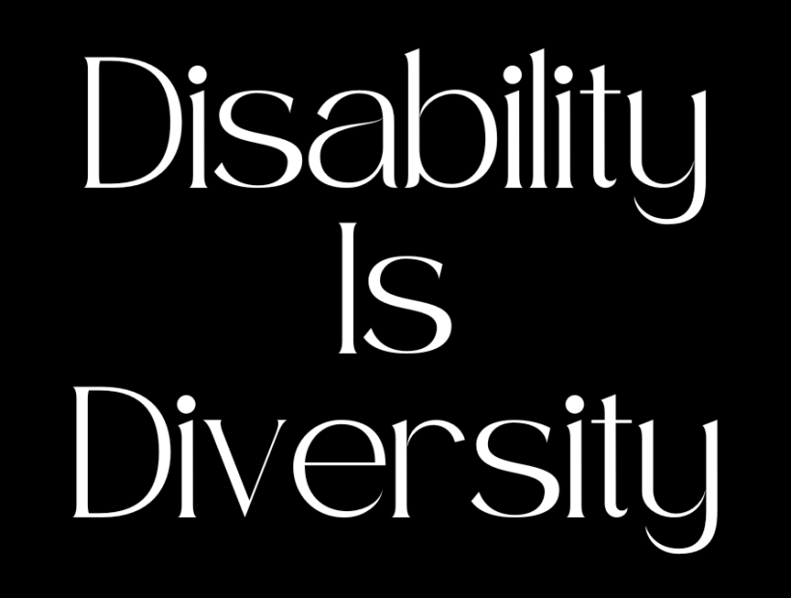
Accessibility Fosters Inclusion & Belonging
Power and privilege creates barriers to access
Disability intersects across multiple marginalized identities
Disability inclusion involves actively engaging individuals with disabilities in everyday activities and promoting opportunities for them to assume roles comparable to their peers without disabilities.
Accessibility is about planning for diverse needs
Using accessible spaces for classes and events
Making accessible entrances the primary entrance for events
Use captions for in-person and online events
Using multiple formats for materials
Provide breaks & allow people to leave as needed
Providing clear guidance on policies and expectations
Operating from a trauma-informed lens
Be aware of the language we use and its impacts
Consider course design and if it creates barriers to learning for some populations
Notes:
Using the frameworks we have discussed, let’s talk a little about accessibility fostering inclusion and belonging. Disability intersects across multiple marginalized groups. Disability inclusion involves actively engaging individuals with disabilities in everyday activities and promoting opportunities for them to assume roles comparable to their peers without disabilities.
Maintaining an inclusive and accessible environment is about recognizing our own power and privilege when we enter a space and how that can create barriers to access, particularly for multiply-marginalized students and employees alike. It is important that we recognize that access is about more than the ADA and Section 504, it’s about recognizing the space we are in and our roles, and how those roles interact and intersect with those around us. Looking at that Power & Privilege Wheel, how do the identities of power we hold interact with the marginalized identities in the spaces we are in around campus, physically or virtually.
Disability inclusion involves actively engaging individuals with disabilities in everyday activities and promoting opportunities for them to assume roles comparable to their peers without disabilities.
Accessibility is viewing disability needs through an inclusive lens instead of minimal compliance. This means reviewing departmental and program policies and practices for inclusivity and accessibility and evaluating the “why” behind the practices in place. If the answer to “why do we do things this way?” is “we have always done it this way,” then it’s probably time to reevaluate.
Accessibility is more than passing a Microsoft accessibility check, although that is important! It is about proactively planning for diverse needs – having captions available, multiple formats for materials, reviewing all spaces for access and a quiet space to retreat to for those that need it, providing clear guidance on policies and expectations, operating from a trauma-informed lens, and being aware of the language we use and its impacts on others.
Accessibility is about planning for diverse needs
Using accessible spaces for classes and events
Making accessible entrances the primary entrance for events
Use captions for in-person and online events
Using multiple formats for materials
Provide breaks & allow people to leave as needed
Providing clear guidance on policies and expectations
Operating from a trauma-informed lens
Be aware of the language we use and its impacts
Consider course design and if it creates barriers to learning for some populations

Slide 30
Center Your Work in Equity
Consider these 4 pillars of the ADA:
Full Participation
Is the course/program/event inclusive for all or a “weeder” that tends to screen out some marginalized populations?
Independent Living
Are we increasing accessible spaces on campus?
Equal Opportunity*
Are all participants receiving equal opportunity to benefit from services?
Economic Self-sufficiency
Are we actively working to eliminate disability bias in our hiring and hiring disabled students, faculty and staff at competitive salaries?
Can this be accessed by folx with physical, cognitive, auditory, and visual impacts?
*Note that Equal Opportunity does not mean all are treated equally
Notes:
Center your Work in Equity. The ADA was designed with these 4 pillars in mind: To promote Full Participation by individuals with disabilities, Independent Living, Equal Opportunity, and Economic Self-Sufficiency. Let’s break this down a little bit further:
Full participation: Can this be accessed by folx with physical, cognitive, auditory, and visual impacts? Is the course/program/event inclusive for all, or is this a “weeder” that tends to screen out some marginalized populations?
Independent living: Are we increasing accessible spaces on campus?
Equal opportunity: Remember that graphic of the white board where everyone was given the same chance to participate but not benefitting equally? Are all participants receiving equal opportunity to benefit from services? Equal opportunity does not mean all are treated equally.
Economic Self-sufficiency: Are we actively working to eliminate disability bias in our hiring and hiring disabled students, faculty, and staff at competitive salaries?
Each disabled person has a different lived experience of it, influenced by the societal barriers encountered and access to resources and support
Emphasize the whole personhood of the populations you work with, and in the work you do

Slide 31
Inclusive Practices for Employees with Disabilities
Aaron Pena, Workplace Accommodations Specialist MSU Employee and Labor Relations
Notes:
AP

Slide 32
Common Challenges
Physical Barriers
Lack of Accommodations
Societal Attitudes and Prejudice
Lack of Awareness and Training
Invisible Disabilities
Disclosure Concerns
Notes:
AP
To create an inclusive workplace, we first need to understand what the challenges are. Some common challenges when it comes to creating this environment are the following:
Physical Barriers: Many workplaces aren't fully accessible. They often miss features like ramps, elevators, or accessible restrooms.
Lack of Accommodations: Some employers don’t provide the necessary support or accommodations that people might need. Additionally, there can be financial challenges for employers in providing this support.
Societal Attitudes and Prejudice: Negative attitudes and stereotypes about disabilities can lead to discrimination and exclusion.
Lack of Awareness and Training: Many employers and coworkers don't understand disabilities well or know how to support their colleagues with disabilities.
Invisible Disabilities: Some disabilities, like mental health issues or long-term illnesses, aren't visible, making it tough for those employees to get the help they need.
Disclosure Concerns: Some people hesitate to share their disabilities because they worry about being treated differently or facing negative reactions.

Slide 33
Benefits of an Inclusive Workplace
Enhanced Morale and Job Satisfaction
Increased Productivity
Better Employee Retention
Access to a Broader Talent Pool
Improved Workplace Culture
Innovation and Creativity
Positive Reputation
Notes:
AP
Enhanced Morale and Job Satisfaction: When employees feel their different needs are recognized and met, they feel valued and respected. This boosts their happiness and job satisfaction.
Increased Productivity: Inclusive workplaces allow everyone to do their best work, which helps the company overall.
Better Employee Retention: Companies that focus on including people with disabilities tend to have lower employee turnover because people want to stay with a business that values diversity.
Access to a Broader Talent Pool: By being inclusive, companies can find a wider variety of skills and talents, including those from people with disabilities who may be overlooked otherwise.
Improved Workplace Culture: An inclusive workplace creates a respectful and collaborative culture that benefits all employees, not just those with disabilities.
Innovation and Creativity: Diverse teams come up with fresh ideas and perspectives, leading to innovative solutions and creative ways to tackle problems.
Positive Reputation: Companies that are known for being inclusive often have a better reputation, which can help them attract talented employees and loyal customers.

Slide 34
Inclusive Hiring Practices
Interview Accommodations: Offering necessary support during the interview process.
Recruitment: Collaborate with organizations that advocate for individuals with disabilities and utilize inclusive language in job postings.
Inclusive Job Descriptions: Ensure that job descriptions are free from biased language and emphasize essential skills over specific experiences.
Diverse Hiring Panels: Incorporate individuals from diverse backgrounds in the hiring process to minimize unconscious bias.
Bias Training: Implement training for hiring managers to enhance awareness and reduce bias during the recruitment process.
Notes:
AP
Inclusive practices start even before someone becomes an employee, beginning with the hiring process. Here are some steps employers can take to promote inclusivity during hiring:
Interview Accommodations: Offering necessary support during the interview process. This can include the following:
Providing the candidate a copy of questions in advance
Changing the format of the meeting from in-person to virtual
Providing easily accessible parking and meeting space
One-on-one interviews instead of panel interviews
Recruitment: Collaborate with organizations that advocate for individuals with disabilities and utilize inclusive language in job postings.
Inclusive Job Descriptions: Ensure that job descriptions are free from biased language and emphasize essential skills over specific experiences.
Diverse Hiring Panels: Incorporate individuals from diverse backgrounds in the hiring process to minimize unconscious bias.
Bias Training: Implement training for hiring managers to enhance awareness and reduce bias during the recruitment process. Some common biases include:
Implicit bias - Unconscious preferences or attitudes we have towards certain people or groups, often without realizing it.
Contrast effect bias – Comparing a candidate to the previous interviewee.
Halo effect - Allowing one positive quality of a person influences our overall impression of them.
First impression bias - Forming an opinion about someone based on our initial encounter, which can strongly influence how we see them moving forward.

Slide 35
Creating an Inclusive Workplace
Understand and Avoid Generalizations
Avoid Assumptions
Personalized Support
Advocate for Inclusive Practices
Promote Awareness
Inclusive Policies
Accessible Communication
Clear and Simple Language
Accessible Presentations
Inclusive Events
Event Planning.
Foster an Inclusive Community
Community Building
Training and Awareness
Disability Awareness Training
Unconscious Bias Training
Notes:
AP
Understand and Avoid Generalizations: Refrain from making assumptions about an individual's abilities based on their disability. Recognize that each person's needs and capabilities are distinct. It is important to regularly engage with employees to understand their specific requirements and explore ways to provide support.
Advocate for Inclusive Practices: Propose ideas and recommendations to leadership that promote inclusive practices. Advocate for the implementation of policies that enhance accessibility and inclusivity, such as flexible work arrangements and the provision of accessible facilities.
Accessible Communication: Use simple and easy-to-understand language in all your messages. Make sure your presentations are friendly for everyone by adding descriptions for images, providing written transcripts for audio, and using colors that are easy to see.
Inclusive Events: Organize workplace events that are welcoming and accessible to all employees. Consider alternatives to activity-centered gatherings, as they may not accommodate everyone's preferences and needs.
Foster an Inclusive Community: Cultivate an inclusive environment by promoting collaboration and mutual support among employees
Training and Awareness: Implement regular training sessions aimed at educating employees about various disabilities and effective ways to support their colleagues. Additionally, address and work to reduce unconscious biases that may impact hiring, promotions, and everyday interactions.

Slide 36
Workplace Accommodations
Reasonable Accommodations: Provide necessary tools and adjustments to help qualified individuals with disabilities perform the essential functions of their job.
Interactive Process: Engage in an ongoing dialogue with employees to understand their needs and provide appropriate accommodations
Notes:
AP
A reasonable accommodation refers to a modification or adjustment made to a job, the work environment, or standard procedures during the hiring process. These adjustments allow individuals with disabilities to have equal opportunities not only to secure employment but also to perform their job responsibilities effectively, comparable to their colleagues without disabilities.
The Americans with Disabilities Act (ADA) mandates reasonable accommodations in relation to three key aspects of employment:
providing equal opportunities in the application process;
enabling qualified individuals with disabilities to carry out essential job functions; and
ensuring that employees with disabilities have access to the same benefits and privileges of employment as their peers
Interactive Process: Engage in an ongoing dialogue with employees to understand their needs and provide appropriate accommodations. This process involves obtaining the necessary documentation, discussing the effects of the disability with the employee, establishing a connection between the disability and essential job duties, brainstorming accommodation options, and implementing the accommodations.

Slide 37
Examples of Reasonable Accommodations:
Physical Accessibility: Ensure that all facilities, including restrooms, entrances, and common areas, are fully accessible.
Digital Accessibility: Guarantee that all digital content and tools are accessible to employees with disabilities by leveraging appropriate technology.
Job Restructuring: Consider modifying job duties, reallocating marginal tasks, or adjusting task performance methods as necessary.
Leave and Breaks: Provide options for additional unpaid leave or breaks as needed.
Modified Work Schedule or Flex Time: Allow for adjustments to work hours or the option for flexible working hours.
Notes:
AP

Slide 38
Supportive Culture
Employee Resource Groups such as support networks.
Implement policies that promote inclusion in the workplaces
Provide training and resources to staff and community members.
Encourage Disclosure
Address Attitudinal Barriers
Inclusive Policies
Compliance
Leadership Commitment
Notes:
AP
Employee Resource Groups such as support networks: Creation of resource groups within the organization or providing resources to groups.
Implement Policies to Promote Inclusivity: Establish and enforce policies that foster disability inclusion and safeguard against discrimination in the workplace.
Provide Training and Resources: Organize regular training sessions designed to educate employees and management on disability inclusion and effective support strategies for colleagues with disabilities.
Encourage Open Disclosure: Foster a safe and inclusive environment where employees feel comfortable disclosing their disabilities, thereby enabling the provision of necessary support and accommodations. This involves creating a culture where employees with disabilities feel secure in requesting accommodations when needed.
Address Attitudinal Barriers: Work to challenge and change negative attitudes and stereotypes regarding disabilities through ongoing education and positive affirmation.
Develop Inclusive Policies: Formulate and uphold policies that advance disability inclusion and protect against discrimination.
Ensure Compliance: Remain informed about legal obligations and best practices related to disability inclusion.
Demonstrate Leadership Commitment: Ensure that organizational leadership visibly supports disability inclusion by actively participating in relevant initiatives and, when appropriate, sharing their personal experiences.

Slide 39
Continuous Improvement
Feedback Mechanisms: Establish channels for employees to share their feedback regarding disability inclusion initiatives.
Regular Reviews: Regularly assess and revise policies and practices to guarantee their effectiveness and inclusivity.
Notes:
AP
Establish mechanisms for employees to provide feedback on disability inclusion initiatives. Examples of such mechanisms include:
- Create ongoing ways for feedback to find areas that need improvement.
- Encouraging employees to share their experiences and perceptions related to workplace culture.
- Offering practical tools for leaders to foster inclusive practices.
- Integrating inclusion metrics into performance evaluations.
Implementing anonymous feedback options and conducting regular pulse surveys.
Continuously evaluate and update policies and practices to ensure their effectiveness and inclusivity.

Slide 40
Intersectionality
Intersectionality in the context of workplace disabilities involves acknowledging and addressing the diverse, overlapping identities that employees may possess, which can influence their experiences and opportunities within the workplace. Below are several key considerations:
Multiple Identities
Compounded Discrimination
Inclusive Policies.
Tailored Accommodations.
Notes:
AP
Intersectionality in relation to disabilities at work means recognizing that employees have different identities that can overlap and affect how they experience their jobs and the opportunities available to them.
Many employees with disabilities also belong to other groups, like different races, genders, or sexual orientations, which can create special challenges and experiences for them.
For instance, someone who is a person of color and has a disability may face more hardships in accessing job opportunities and resources compared to others.
To make sure all employees feel supported, workplaces need to consider how these various aspects of identity interact with one another. This means creating policies that recognize and address these unique situations.
Offering support that takes into account all parts of an employee’s identity can help them feel more included. For example, an employee who has a hearing impairment and is also new to the country might need help with language as well as special devices to assist with hearing.

Slide 41
Resources for additional support
MSU Web Accessibility Site
MSU Institutional Diversity and Inclusion Disability Pride Guide
MSU Inclusive Language Guide for Disability
Microsoft Creating Accessible Documents
AbilityNet
MSU Trauma Services & Training Network (TSTN)
Duke Accessible Syllabus Project
The RCPD Website
RCPD D2L Training
RCPD Learning Community

Slide 42
References
Crenshaw, Kimberle (1989) "Demarginalizing the Intersection of Race and Sex: A Black Feminist Critique of Antidiscrimination Doctrine, Feminist Theory and Antiracist Politics," University of Chicago Legal Forum: Vol. 1989, Article 8. Available at: https://chicagounbound.uchicago.edu/uclf/vol1989/iss1/8
National Association of Independent Schools (NAIS). (2018). Kimberlé Crenshaw: What is Intersectionality? In YouTube. https://www.youtube.com/watch?v=ViDtnfQ9FHc
Shaewitz, D., & Crandall, J. R. (2020, October 19). Higher Education’s Challenge: Disability Inclusion on Campus. Higher Education Today. https://www.higheredtoday.org/2020/10/19/higher-educations-challenge-disability-inclusion-campus/
Hallam, L. (2023, October 21). Intersectionality in Mental Health: Addressing the Unique Needs of Marginalized Populations [Review of Intersectionality in Mental Health: Addressing the Unique Needs of Marginalized Populations]. HubPages. https://discover.hubpages.com/health/intersectionality-in-mental-health-addressing-the-unique-needs-of-marginalized-populations
Puttman, K. (n.d.). 1.4 Social Problems in a Diverse World. Openoregon.pressbooks.pub. https://openoregon.pressbooks.pub/socproblems/chapter/1-4-social-problems-in-a-diverse-world/
‌Niels de Fraguier. (2022, June 7). Intersectionality: acknowledging privileges and power for future-fit leadership. Medium; Medium. https://niels-defraguier.medium.com/intersectionality-acknowledging-privileges-and-power-for-future-fit-leadership-4be921b06494
Lewis, T. (2022, January 1). Working Definition of Ableism - January 2022 Update. TALILA A. LEWIS. https://www.talilalewis.com/blog/working-definition-of-ableism-january-2022-update
‌Americans with Disabilities Act of 1990, As Amended. (n.d.). ADA.gov. https://www.ada.gov/law-and-regs/ada/#subchapter-ii---public-services-title-ii
x.com. (2024). X (Formerly Twitter). https://x.com/DisInHigherEd/status/1444740571780821003
‌Nielsen, K. E. (2012). Disability History Of The United States. Beacon.
Ableism Basics – EqUUal Access. (n.d.). https://www.equualaccess.org/resources-2/ableism-basics/

