Slide 1
Faculty Panel: Managing Accommodations
Facilitated by Hannah Huey-Jones & Jessica Lutz, RCPD Access Specialists

Slide 2
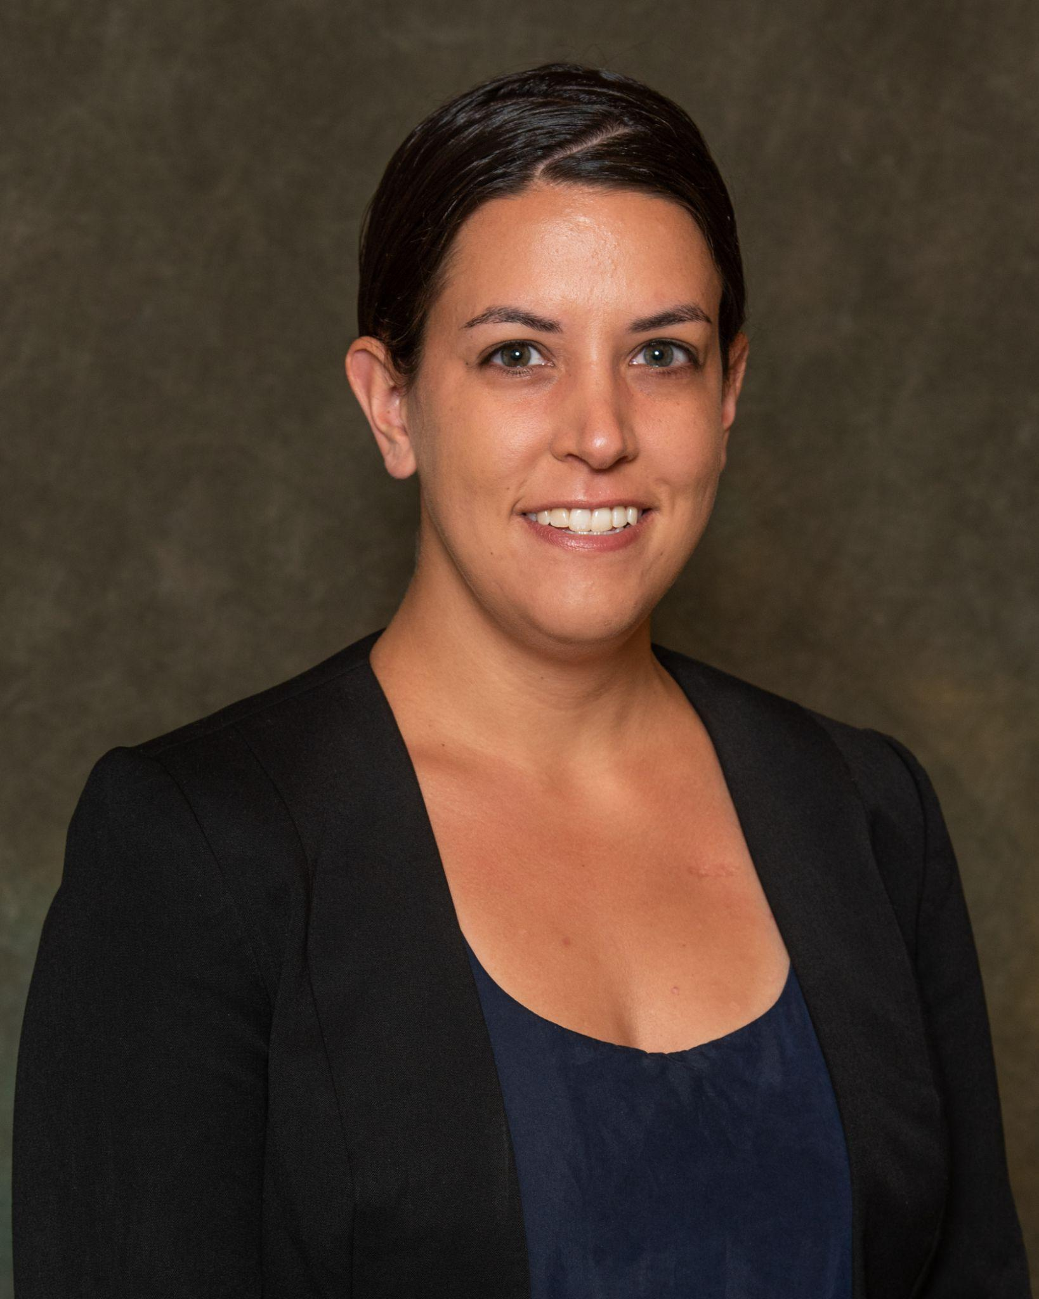
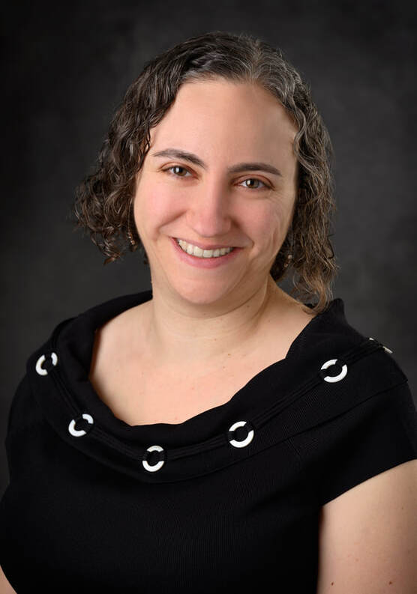
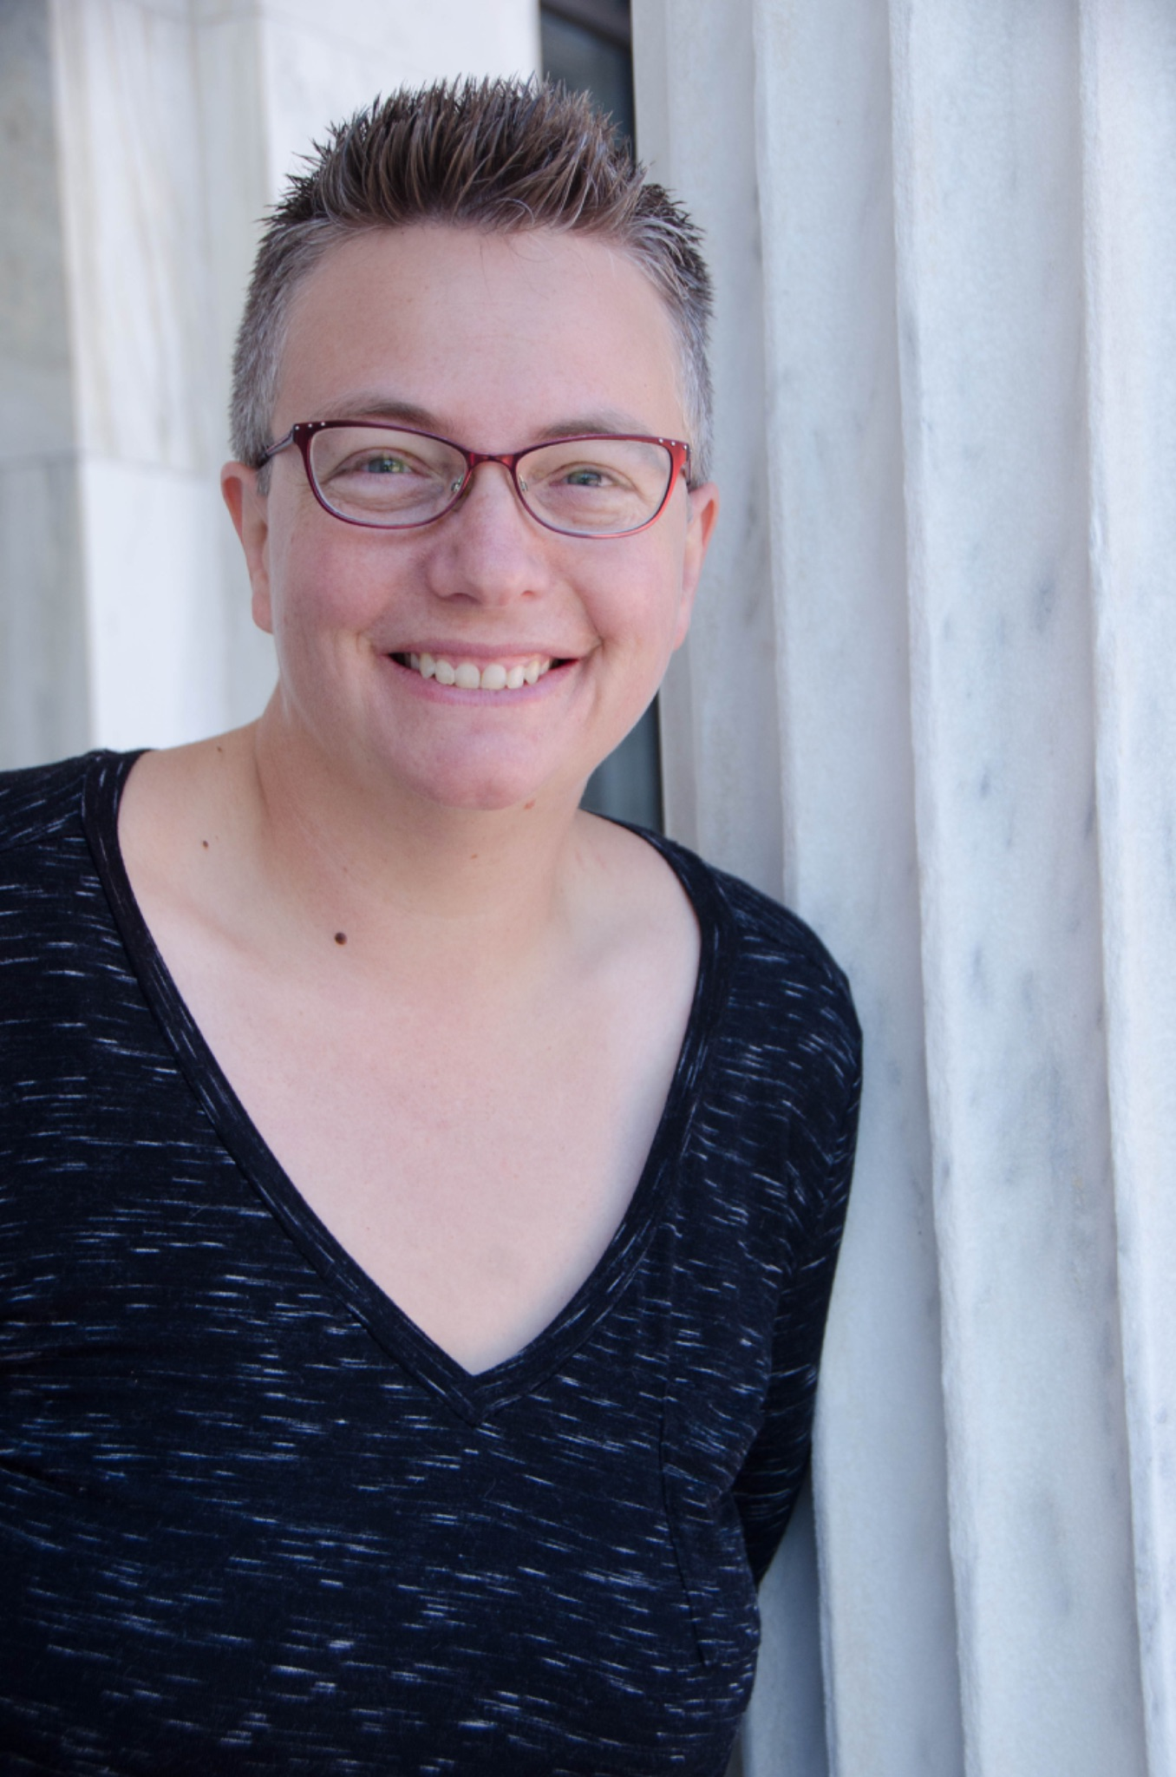
Panelists
Daryl McPadden, PhD
Assistant Professor, Physics Education Research
Juliet Hess, PhD
Associate Professor,
Music Education
Dawn Burns, MFA
Assistant Professor, WRAC

Slide 3
Many of us were taught inaccessible teaching practices when we started our teaching journey, simply because they were standard practices.
Was there a moment when you shifted your thinking from what you had been taught toward more accessible practices?
Talk about your process.

Slide 4
What do you wish people knew about accessibility in education?

Slide 5
What are some best practices you have found in terms of classroom accessibility/implementation of accommodations?

Slide 6
What can instructors do to support and act as an ally, recognizing that every student has a different relationship to their disability and have varying levels of comfort with disclosure?

Slide 7
Our keynote speaker, Jay Dolmage, writes about the ableism inherent in higher education.
What can we, as people working in higher education, do to seek change?

Slide 8
Thanks for attending!

