Slide 1
Michigan State University
Disability in Higher Education Summit
Jay Dolmage (dolmage@uwaterloo.ca)

Slide 2
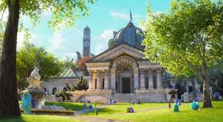
Steep Steps: Monsters University

Slide 3
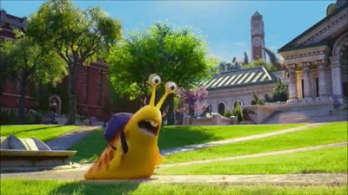
Steep Steps: Monsters University

Slide 4
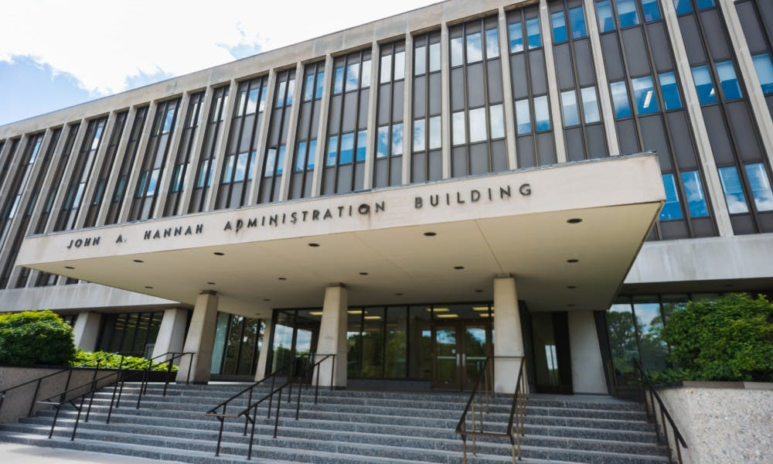
Steep Steps:
Hannah Administration Building

Slide 5
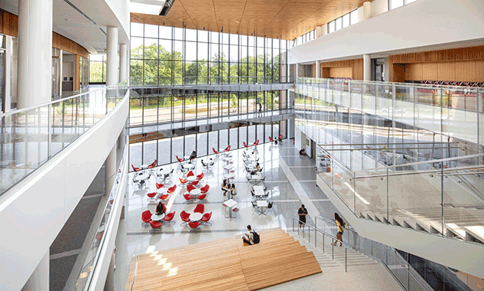
Steep Steps: Minskoff Pavilion

Slide 6
Steep Steps: Worst Staircase at MSU

Slide 7
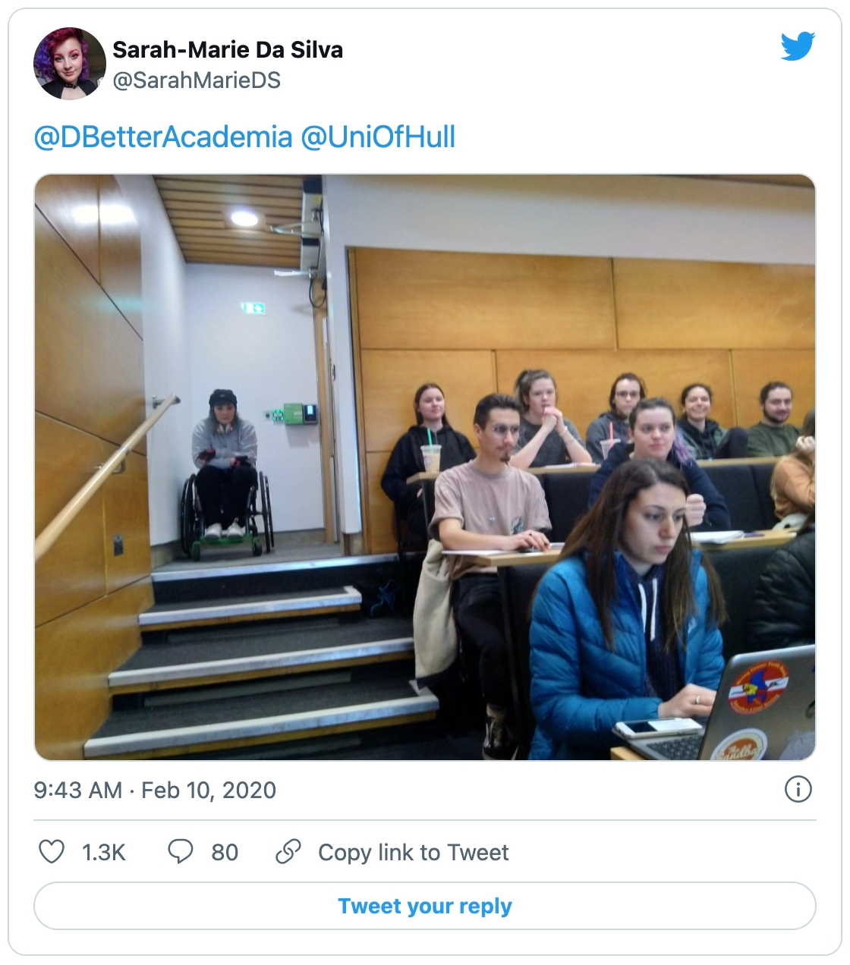
Retrofitting at the University of Hull

Slide 8
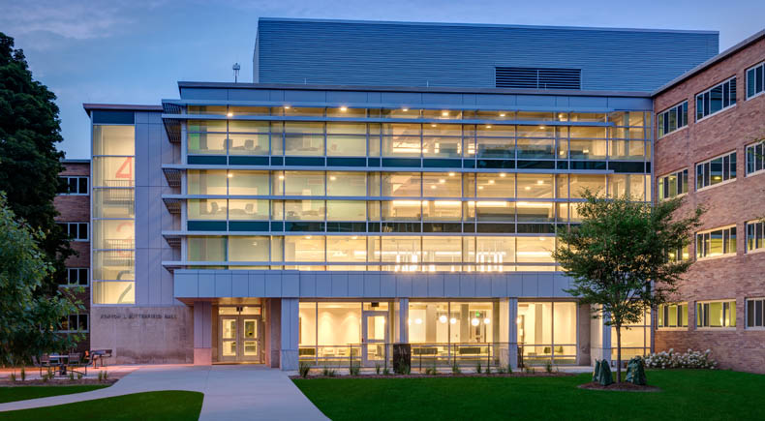
Universal Design: Butterfield Hall

Slide 9
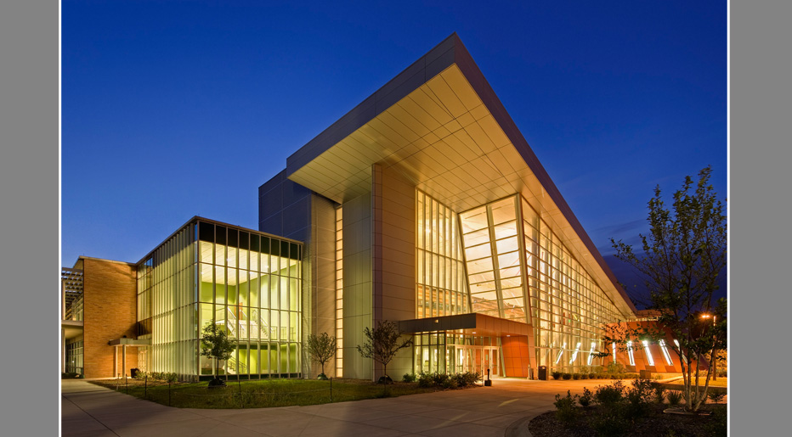
Universal Design: Brody Hall

Slide 10
Universal Design For Learning:
Multiple means of representation, to give learners various ways of acquiring information and knowledge;
Multiple means of expression, to provide learners alternatives for demonstrating what they know;
Multiple means of engagement, to tap into learners' interests, offer appropriate challenges, and increase motivation.

Slide 11
Academic Ableism in Open Access version here: https://www.fulcrum.org/concern/monographs/1c18dg49d
List of Universal Design ideas for teaching: https://bit.ly/3f7zn8p

Slide 12
Resources for access: www.beyondaccommodation.wordpress.com

