Slide 1
Neurodiversity & Non-Apparent Disabilities
Kelsey Foote & Lindsay Hill
RCPD Access Specialists
MA, CRC, LPC

Slide 2
Disclaimer! This is just an introduction

Slide 3
Non-Apparent Disabilities
Many mental health, neurological, learning and chronic health-related disabilities are non-apparent to the casual observer.
People with these disabilities often experience additional ableism for several reasons
Examples of non-apparent disabilities: autism, depression, diabetes, and learning and thinking differences such as ADHD and dyslexia. Non-apparent disabilities can also include symptoms such as chronic pain, fatigue, and dizziness.
Why "non-apparent" instead of "invisible"?
not all apparent disabilities are visible
disabilities that have been labeled as "invisible" such as anxiety, depression, etc. may become visible when someone is experiencing heightened impacts like a panic attack
by using labels such as "apparent" and "non-apparent," there is more room for understanding disability as a fluid experience that ebbs and flows.
Notes:
Ableism: not being believed about their disability, having their disability impacts written off as personal failings (laziness, disorganization, lack of drive).

Slide 4
Neurodiversity & Neurodivergence
Neurodiversity
Individual differences in brain functioning regarded as normal variations within the human population. Differences should not be stigmatized. Variations are not seen as deficits.
Overall: the concept of diversity, applied to how our brains function. Think: "biodiversity"
Neurodivergent (ND)
Describes people whose brains are significantly different to what is expected in the “typical” population. Differences might be innate (e.g., autism) or acquired (e.g., brain injury), and include medical conditions(e.g., epilepsy), mental health conditions (e.g., trauma), learning disabilities (e.g., dyslexia) and other neurodevelopmental conditions (e.g., ADHD).
Neurotypical: societal standard of "normal" functioning

Slide 5
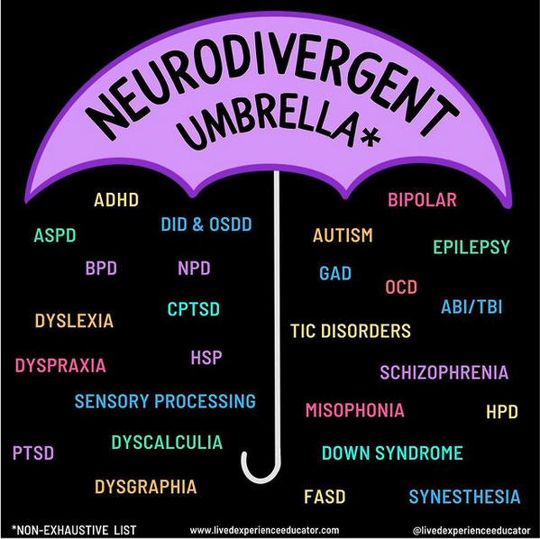
Common Neurodivergence
Oftentimes, "neurodivergence" refers to the diagnoses of ADHD, autism, and learning disabilities. However, there are many other conditions that fall under this definition.
Folks can use this way of identifying themselves or not!
https://www.livedexperienceeducator.com/​

Slide 6
Medical Model of Disability
Labeling diagnoses originated from the medical model of disability: disability is something "wrong" to be treated/"fixed"
There are MANY people who consider themselves/would be considered neurodivergent who don't have a medical diagnosis for a variety of reasons
lack of access to healthcare/resources for obtaining a diagnosis, family/cultural belief systems, not wanting a "label", not having access to information about neurodivergence, doing "too well" in school to be noticed by special education services
Notes:
As opposed to the social model

Slide 7
Neurodivergence at RCPD
This is the rough percentage of RCPD students registered with neurodivergence – definitely an underestimate!
78%
Notes:
Specifically in our system: E, F, I
Underestimate: our system is old and it is difficult to pull reports; some brain injuries, chronic health conditions like epilepsy, other neurological conditions, etc, may fall under the neurodivergence "umbrella"

Slide 8
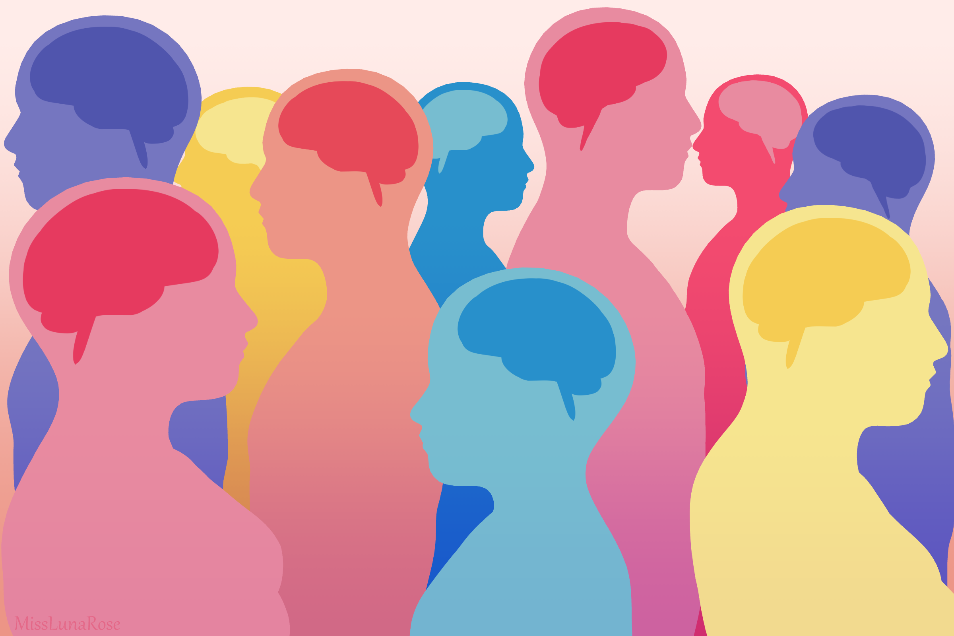
Strength in Neurodiversity
Like diversity in any sense, neurodiversity provides us with valuable and needed differences in thought processes and problem solving.
This Photo by Unknown author is licensed under CC BY.
Notes:
How would we move forward with new ideas, strategies, etc., without differences in how we think, respond, and create? Business models, new products, solving problems big and small...the list goes on...NEED neurodiversity to succeed. We need to accept exploration of the world through different lenses in order to create equitable processes and practices in our communities. We BENEFIT from neurodiversity. We need to value diversity in all senses, including neurodiversity.

Slide 9
Strengths of Neurodivergence
Many see neurodivergence as a collection of deficits. However, there are endless strengths to consider...
Creativity
Resilience
Attention to detail
Depth of thought
Memory
Empathy
Passion
Notes:
Kelsey – these are GENERAL ideas of strengths, these vary from person to person
Creativity: different ways of thinking will uncover new ideas and solutions. Neurodivergent individuals often need to be creative in their approaches to the neurotypical world.
Resilience: there are many situations where being neurodivergent is challenging (stress of living within the constructs of a neurotypical world, stigma, connecting to others, etc.). Resiliency is developed naturally when exposed to challenges.
Attention to detail/depth of thought: neurodivergent individuals may experience hyper focus and notice details that would otherwise go unnoticed. Strengths in verbal or visual thinking/memory can come with neurodivergence.
Empathy: neurodivergent individuals may have a better understanding of what it means to be in a minority, to be treated differently than their peers, etc. Empathy for others in similar situations may stem from this.
Passion: hyper focus into certain topics, increased energy, information processing ability, creativity, empathy, etc., may funnel into an increased passion for school, work, social justice, etc. Etc. Etc.

Slide 10
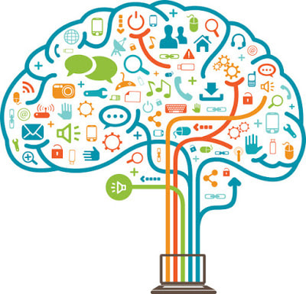
Common Impacts of Neurodivergence
Executive Dysfunction
Tangential thinking
Working memory deficits
Time management/organization
Distractibility
Lack of awareness/self-awareness
Emotion regulation
Concentration/focus
Planning
Communication
Social interactions
Stress management
Motivation
BUT….

Slide 11
Thinking about impacts as differences, not deficits
Impacts of nonapparent disabilities/neurodivergence tend to be seen negatively by others because we are looking from a pathology lens (where the ideal outcome is compliance) and from a neuronormative lens where we prioritize the neurotypical experience
From a neurodiversity lens, people should get to decide what is functional and dysfunctional
There is not one right way to be/to do things. Executive functioning skills and brain/body function are a spectrum.

Slide 12
Sonny Jane Wise (they/them) @livedexperienceeducator
Sonny Jane Wise [@livedexperienceeducator]. Photo series of quotes related to executive functioning. Instagram. 12 September 2024, https://www.instagram.com/p/C_1wqv1Sukv/?igsh=MWw5b3FnZHU0ZzAzcw==

Slide 13
Sonny Jane Wise cont.
"I'm not saying our challenges with executive functioning aren’t disabling, because they are, but I am saying that lacking certain EF skills doesn’t mean there's something biologically wrong with our brains"
"Understanding how executive functioning skills are actually a set of rules shaped by white supremacy has allowed me to shift the blame from myself and instead, accommodate my differences without viewing them as personal failings"
Sonny Jane Wise [@livedexperienceeducator]. Photo series of quotes related to executive functioning. Instagram. 12 September 2024, https://www.instagram.com/p/C_1wqv1Sukv/?igsh=MWw5b3FnZHU0ZzAzcw==​

Slide 14
Language Matters!
Person first vs. Identity first language ​
​ Identity is decided individually. As are communication preferences.
Listen to the person you are talking to! ​
Notes:
Everyone does not feel the same about their disability. Disabilities can start at birth or at any point in life. There might be pride, a sense of identity, empowerment. Others might experience shame, a sense of loss, or wanting to hide their disability. And everywhere in between.

Slide 15
Language Matters (2)
General language: the words “disability” and “disabled” are okay to use! Trying to dance around the words by saying “differently abled”, “special needs”, “(dis)Ability”, “mentally/physically challenged” is usually offensive and can promote bias. Avoid making up words to describe disability.
“High functioning” or “low functioning” are outdated and can be offensive. What to say instead? “access needs”
Saying someone “suffers from” a condition places judgment. Just because someone has a disability doesn’t mean they are suffering.
Think about common language you might use and how it can be stigmatizing: “she’s a psycho”, “that’s crazy”, “wheelchair bound”, “I’m so OCD”
When it’s relevant: ASK preferences!
MSU Brand Studio has an inclusive guide, including disability info/terminology!

Slide 16
Language Matters (3)
Believe people when they have a need for accommodations or disclose they have a disability. Create an atmosphere of encouragement and validation.
Questioning a person’s need for an accommodation sends the message that
disabilities (especially nonapparent disabilities) are not real,
people with disabilities cannot be successful or,
the person may not “actually” have a disability

Slide 17
Considerations for Neurodivergent & Non-apparent Disability Experiences
Masking: changing behavior, communication style, etc. to conform to neurotypical standards
Burnout
Chronic stress
Communication/social difficulties
Sensory sensitivities
Notes:
Masking: this can take significant energy. Neurodivergent individuals may feel this is necessary to fit in, form relationships, or avoid ridicule/bullying.
Burnout: extra energy spent on work or "fitting in" socially creates extra stress = faster burnout
Chronic stress: managing impacts of disabilities can be exhausting if the right supports aren't in place (and sometimes, even if the right supports ARE!). Difficulties with executive function and communication can cause additional stress, past the "normal" stressors of the workplace.
Communication/social difficulties: creating relationships at work, finding time to socialize during the work day, masking, asking for help, keeping track of multiple communication systems (email, Teams, phone, verbal, meeting notes, etc.)
Sensory sensitivities: fluorescent lights, smells (perfumes, oil diffusers, cleaning products, foods), noise levels, clothes, temperature

Slide 18
Culture (1)
Universal design: truly inclusive environment may mean that some accommodations aren't needed, but this doesn't negate all accommodations! For example: always using a microphone/captions, ensuring accessible events & documents, monitoring environment for extremes (temperature, sound, light, etc.), allowing adequate processing time during presentations/conversations
Scheduling: offer as much notice/info as possible and have policies for emergency situations. Surprise meetings, after hours communications about office closures, and meetings without context can cause stress and confusion.
Mandatory "fun": make it flexible and opt-in! Give LOTS of info in advance.
Dress codes: what's necessary and why? Can there be flexibility? Individuals may have sensory concerns or difficulty understanding norms.
Toxic positivity: an environment where showing signs of weakness or asking for help is taboo. Demonstrate and encourage honest communication and normalize emotional responses. Neurodivergent folks may have specific impacts related to emotional regulation and understanding social communication.

Slide 19
Culture (2)
Flexibility is good for everyone! Think: disabled people, parents, caregivers.
Consistency is important for many neurodivergent folks BUT executive functioning impacts may require flexibility.
Use inclusive language: identity-first and person-first are both common. Don't use disability diagnoses or neurodivergent traits to describe behaviors ("I'm so ADHD today!").
Listen! To neurodivergent folks. "Just try harder" is not good advice, but we hear it all the time
Educate yourself on neurodivergent/non-apparent conditions and accessibility. Never make assumptions about skills/personality/abilities/etc. based on a diagnosis.
Confront assumptions or stigma you might hold. What has shaped your thoughts on disability and neurodivergence? How can you actively change those thought patterns?
Remember, just because something has always been done a certain way, doesn't mean it has to stay that way.

Slide 20
Questions?

