Slide 1
Planning & Hosting Accessible Events
MSU Disability in Higher Education Summit 2024

Slide 2
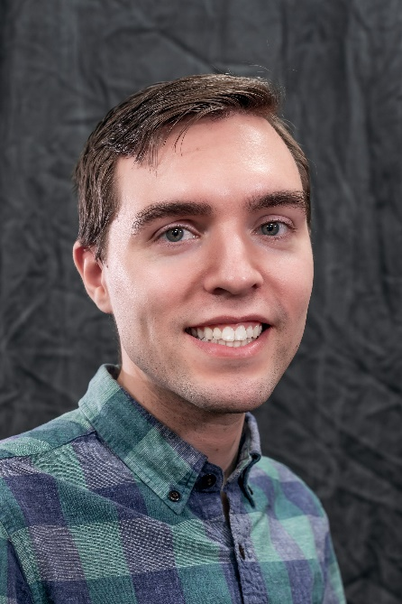
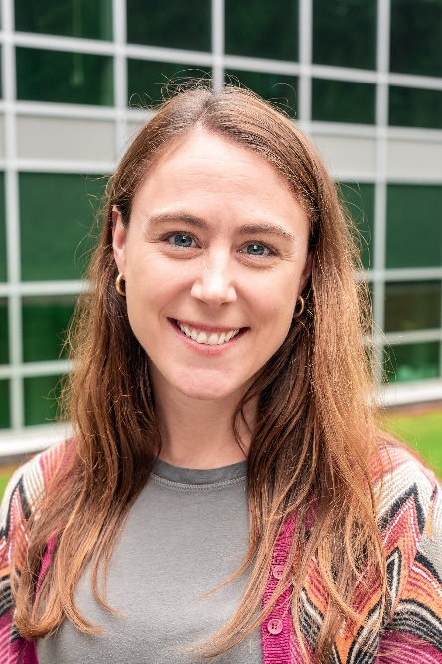
Introductions
Austin Deneau
Accessibility & User Experience Specialist @ MSU Libraires
ad@msu.edu
Heidi Schroeder
Accessibility Coordinator & Liaison to RCPD @ MSU Libraries
hschroed@msu.edu

Slide 3
MSU Libraries Accessibility
Accessibility is a core value of the MSU Libraries
MSU Libraries Strategic Plan
Vision: “The Libraries promote equal access to information and spaces for all. We lead meaningful initiatives in accessibility, diversity, equity, and inclusion.”
Inclusivity Core Value: “We provide welcoming spaces where everyone can work, discover, and create. We advance accessibility, diversity, equity, and inclusion in our workplace and in the services and resources we provide.”

Slide 4
MSU Libraries Accessibility Unit & Services
MSU Libraries Accessibility Unit
lib.msu.edu/accessibility
LIB.DL.Accessibility@msu.edu
Have many accessibility resources & services
Accessibility training, remediation service, collections/e-resources/OER, Assistive Technology Center, UX/website integration, & more!
We incorporate accessibility into other units/areas
Events accessibility was one area of focus this past year

Slide 5
Why host accessible events?
It’s the right thing to do
Enables events to have a larger and broader audience
Improving accessibility often improves the experience for everyone
It’s the law
27% of adults in the United States have some type of disability (CDC)
44% of adults age 65+ have some type of disability

Slide 6
Legal Obligations
Title I of the ADA
Title II of the ADA​
Section 504 of the Rehabilitation Act​
Michigan Persons with Disabilities Civil Rights Act
Prohibits discrimination against people with disabilities

Slide 7
Title II of the ADA​
Building/facilities accessibility
Program accessibility
Web content*
Effective communication
Reasonable modifications
Limitations
Fundamental alteration
Undue burden

Slide 8
Effective communication
The ADA requires that organizations communicate effectively with people who have disabilities.​
Must provide auxiliary aids and services (accommodations) when needed to communicate effectively with people who have communication disabilities.​
Must give primary consideration to the person with a disability’s choice of communication aid or service.

Slide 9
Best Practices
Proactive measures that improve accessibility for everyone

Slide 10
Planning
Budget
Accommodations
Schedule
Consider the needs of your specific audience when selecting times for your event
Be cognizant of conflicts with major cultural and religious holidays​
Religious Observances Calendar provided by MSU’s Office of the Provost​
Include breaks for longer events​
Format
In-person, hybrid, and remote
Recording
For those unable to attend
Allows those who did attend to review the event at their own pace​

Slide 11
Event Accessibility Coordinator
Point person to respond to and implement accommodation requests
Proactively considers accessibility features and accommodations
Typically is the event host for smaller events
Should be a dedicated person for large or complex events

Slide 12
Accessibility Accommodation Statement
State that accessibility accommodations can be made
Provide contact information for accommodation requests
Relevant email and phone number
Optional:
Mention your commitment to accessibility
Encourage people with disabilities to attend
A deadline
Ensure the statement is on all promotional material
MSU Libraries' statement:
“If you have questions about accessibility or need to request accommodations, please email lib.dl.accessibility@msu.edu.”

Slide 13
Promotion
Put an accessibility accommodation statement on all promotional materials
Provide as many details about the event as possible
List proactive accommodations
Follow digital accessibility guidelines​
Use a multi-media approach
Expand representation of people with disabilities in promotional material photos

Slide 14
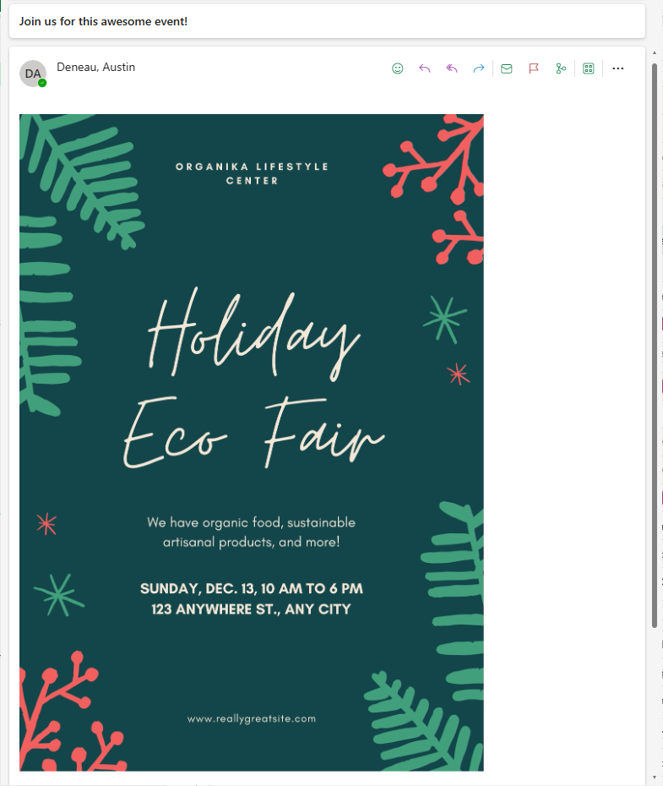
Email Example

Slide 15
Website & Registration
Follow digital accessibility guidelines
Include an accessibility accommodation statement
Ask if accommodations are needed on the registration form
If the online registration is inaccessible the event is inaccessible

Slide 16
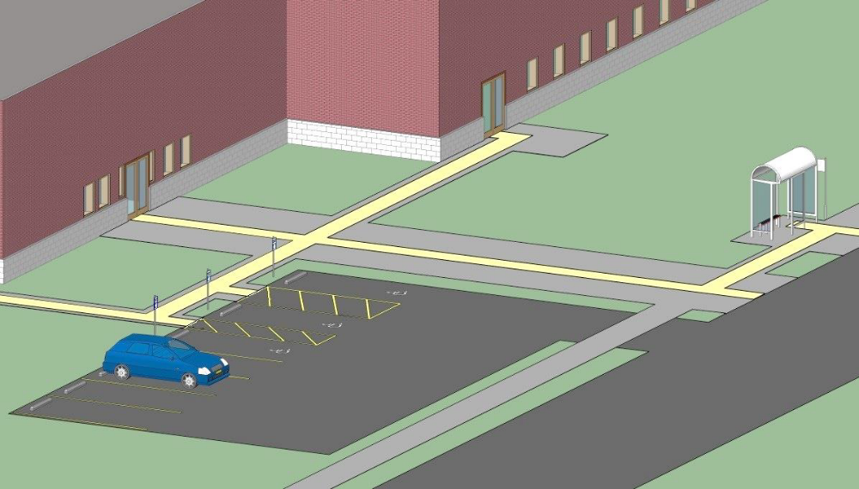
Location
Ensure the venue and location are physically accessible
Parking and transportation
Exterior path of travel
From transit/parking to the event space​
Do a final check right before the event starts
Especially important if the event is held outside

Slide 17
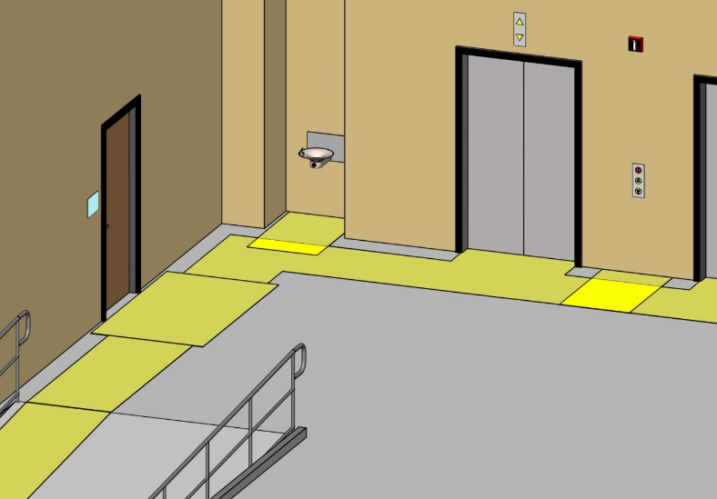
Venue
Interior path of travel
Functioning elevators
Do a final check right before the event starts
Restrooms
Signage and wayfinding
ISPM’s Entryway Accessibility Explorer

Slide 18
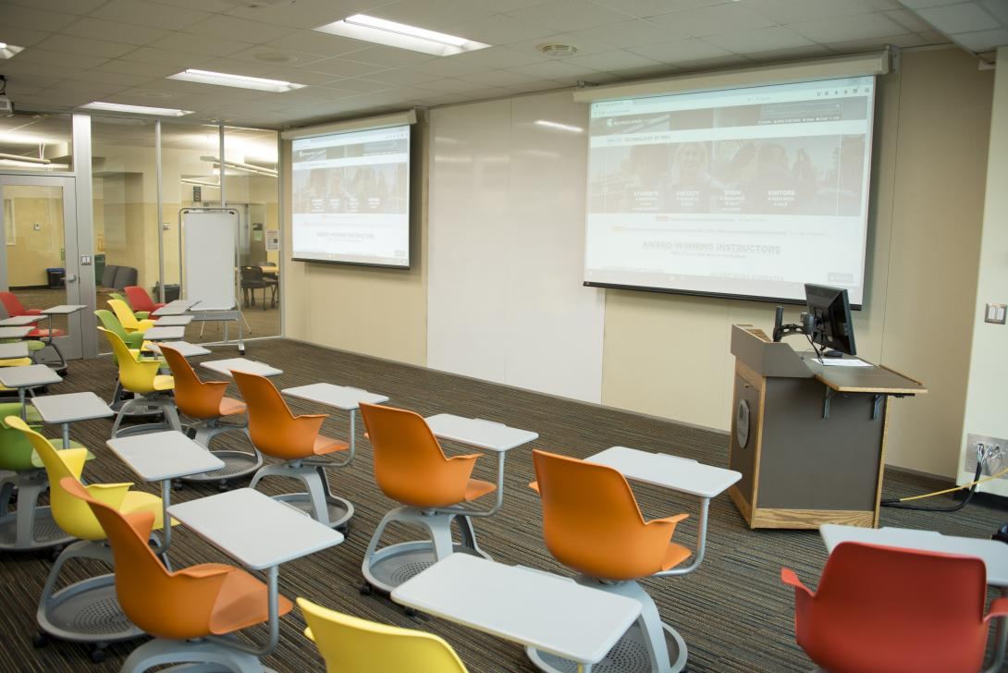
Room Layout
Ensure enough space for people with mobility aids to navigate
e.g. wheelchairs and crutches
Avoid protruding objects and equipment
Commonly cables and signage
Sight lines to presenters, screens, interpreters, etc.
Tables
Seating
Available and a variety of options
Stage and podium

Slide 19
Event Staff
Disability etiquette
What accessibility accommodations are being provided
Be prepared to offer assistance and answer common accessibility related questions
Emergency procedure

Slide 20
Technology
Hybrid/Remote Events
Consider how virtual participants will be able to fully participate during the event
Event Recording
Provide captions, transcript, and event materials
Automatic Captions
Not a replacement for CART or ASL
Zoom, Teams, PowerPoint, Google Slides, etc.
Microphone etiquette
Ensure that the presentation screens are viewable from all areas of the room
Certain lighting and nearby windows may create distracting glare

Slide 21
Accommodations
Typically reactive measures responding to specific requests

Slide 22
Accommodation Requests
Respond to the request as soon as possible
It may take some communication to define their request
Give precedence to their preferred accommodation
Multiple accommodation options may fit their needs
Exceptions (fundamental alteration and undue burden)
Work with ADA coordinator before denying any requests
Last minute accommodation requests
Proactive accommodations
Speaker/presenter accommodations

Slide 23
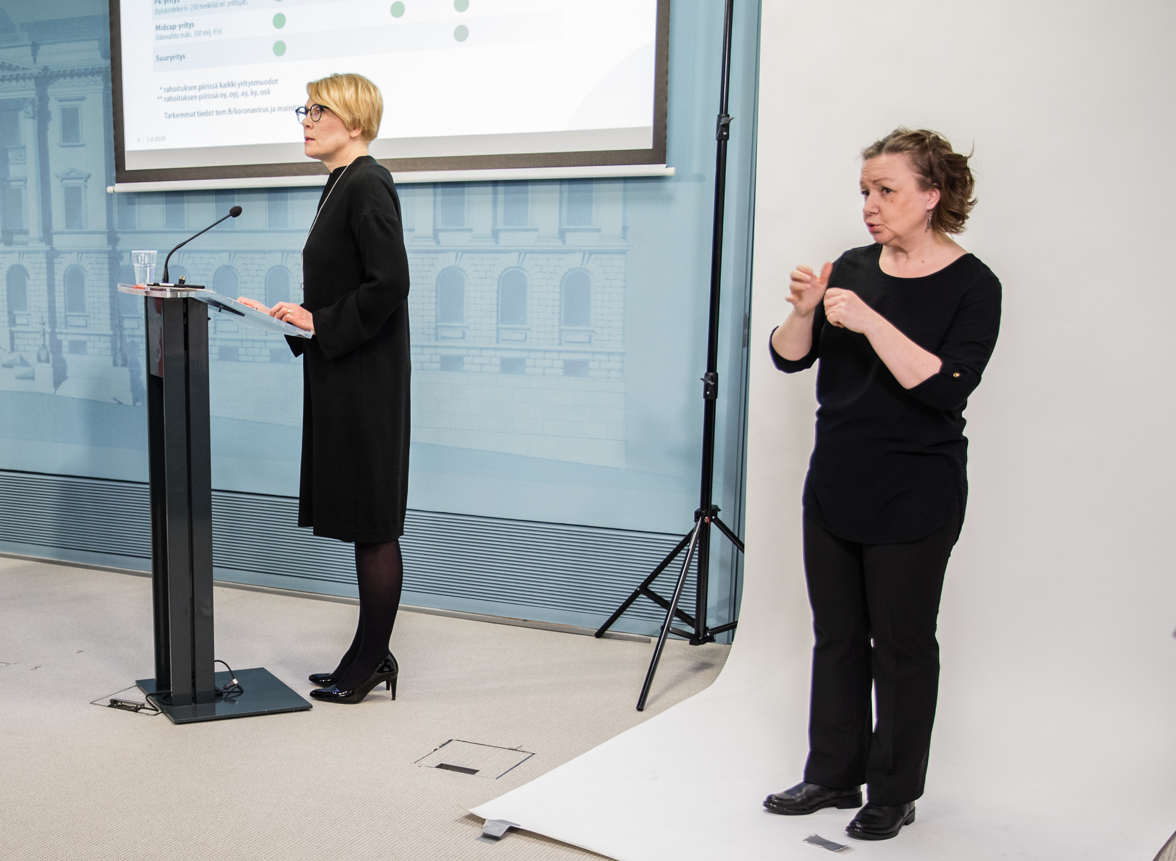
American Sign Language (ASL)
For people who are deaf or hard of hearing
In-person or virtual
May need to provide copies of presentation materials in advance to the interpreters
RCPD ASL interpreter recommendations

Slide 24
Captioning
Typically for people who are deaf, hard of hearing, or have a learning disability
Communication Access Realtime Translation (CART)
In-person or virtual
RCPD CART provider recommendations
Media Captions
For pre-recorded media (movies, videos, etc.)
Auto Captions
Better than no captions
Not a substitute for CART or ASL

Slide 25
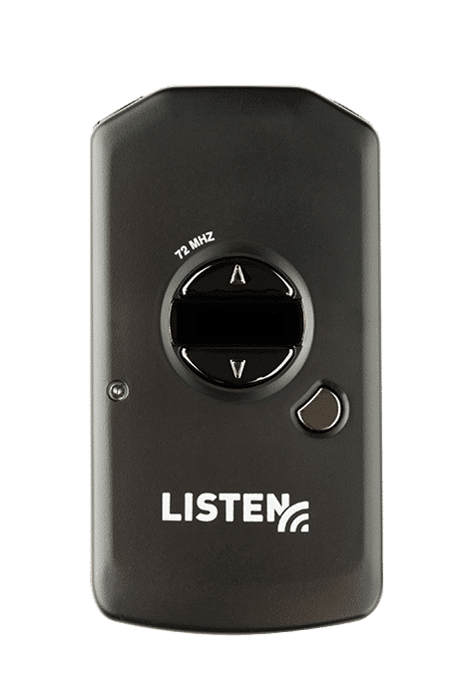
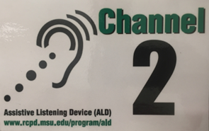
Assistive Listening Devices (ALDs)
Devices that improve sound transmission for people who are hard of hearing
Works in combination with hearing aids, cochlear implants, or other personal sound amplifiers (like headphones)
Over 310 classrooms @ MSU have FM systems
RCPD info on ALDs at MSU

Slide 26
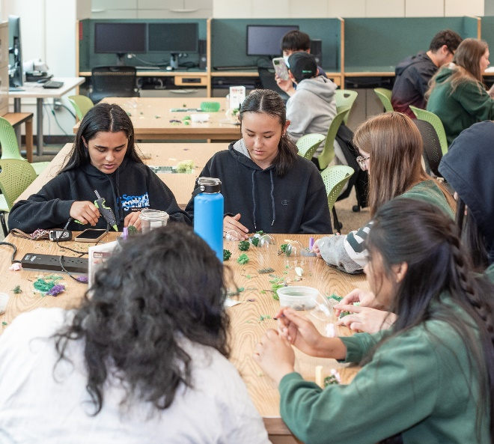
Event Materials & Activities
Includes handouts, slide decks, posters, etc.
Ensure materials are accessible
(regardless of an accommodation request)
Be prepared to provide event materials early and in alternative formats
Digitally, Large print, Braille, etc.
Consider possible alternatives for the event’s activities

Slide 27
Service Animals
Dogs (or miniature horses) that are individually trained to do work or perform tasks for people with disabilities.
Service animal attendance does not need to be known in advance
Provide sufficient floor space around seating and accessible toileting and watering facilities nearby

Slide 28
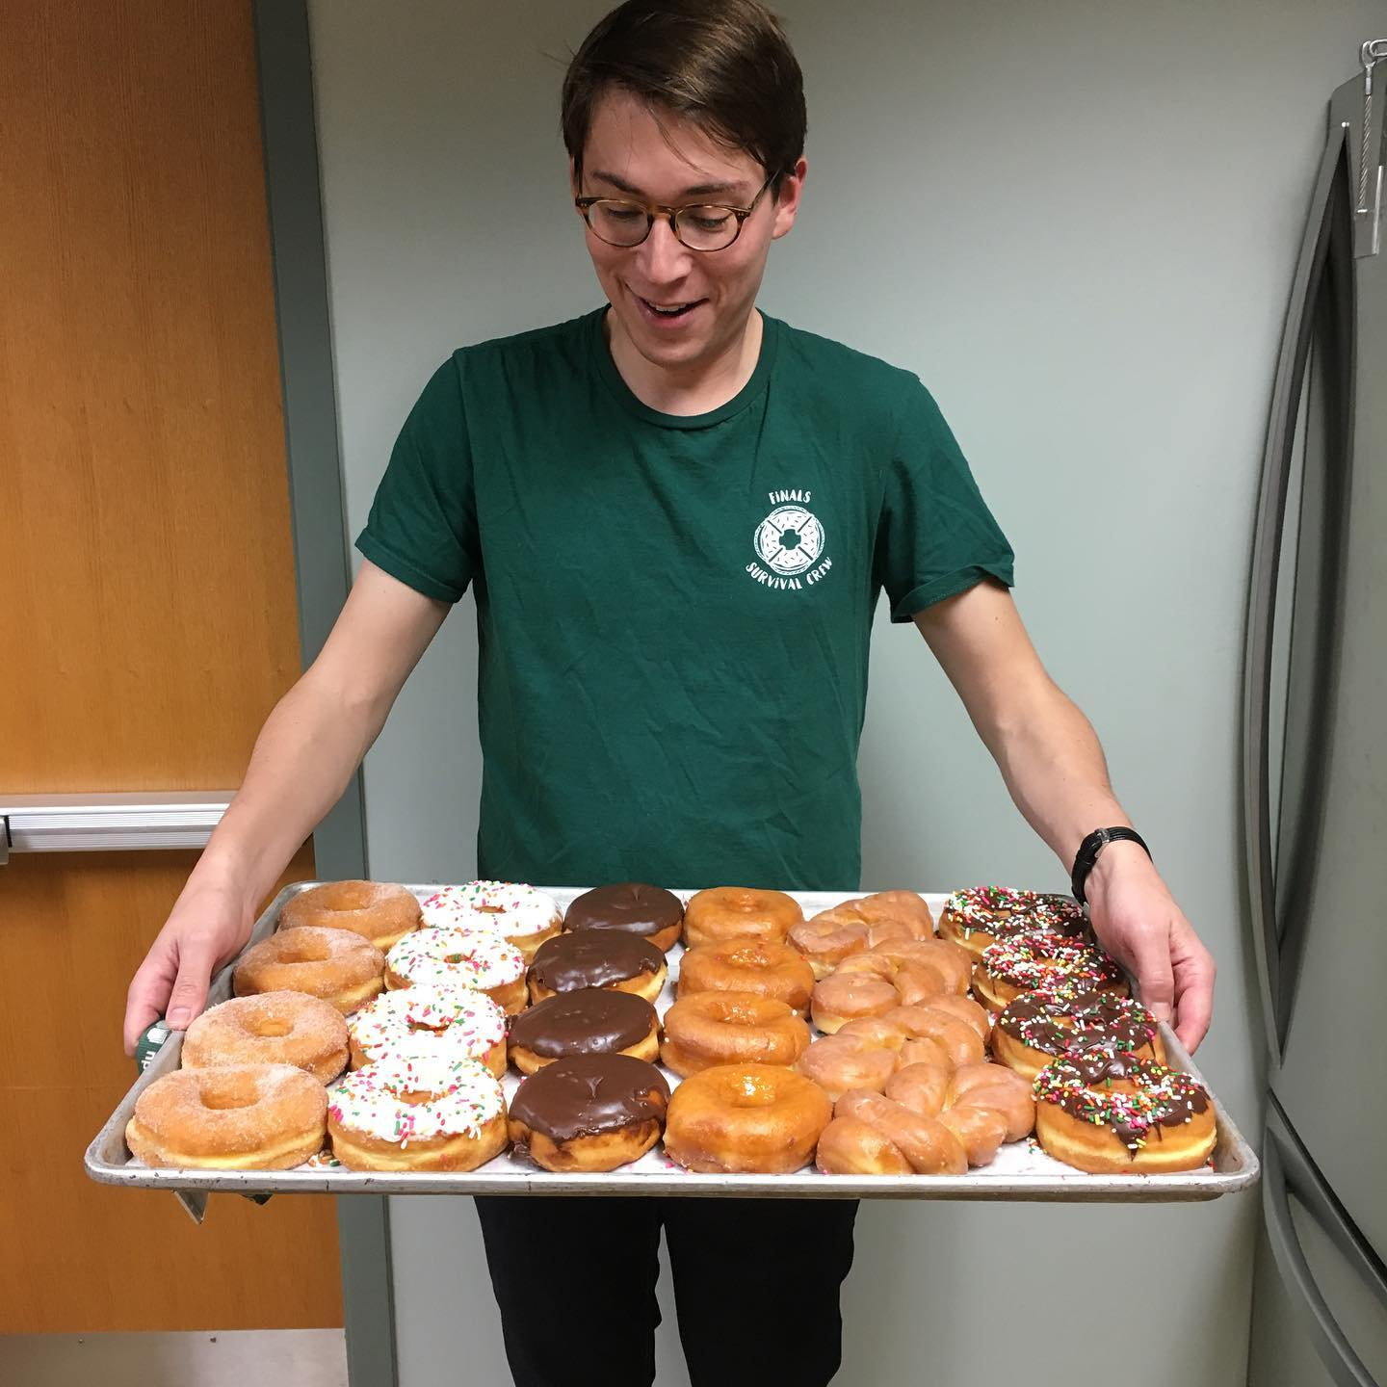
Other Accommodations
Food
Clearly label all food, avoid common allergens, and try to limit cross contamination
Have attendants available if using self-serve style food
Sensory
Notify participants if event will have flashing lights or loud sounds
Motion sickness, including simulation motion (VR and other multimedia)
If possible, provide a quiet break space or reflection room
Chemical Sensitivity

Slide 29
Takeaways
Choose an accessible venue.
Ensure accessible event promotion and registration.
Make it easy to request accommodations.
Be prepared for accommodation requests.
Think about how event's activities and materials will be used by people with disabilities and what modifications may be needed.

Slide 30
Resources
MSU ADA office events accessibility document (Word Doc)
MSU Libraries Events accessibility checklist
MSU Digital Accessibility Site
MSU's ADA/Section 504 Coordinator
Disability & Reasonable Accommodation Policy
Resource Center for Persons with Disabilities (RCPD)
RCPD's Supporting Spartans with Disabilities in Registered Student Organizations (YouTube)

Slide 31
Questions?
You can also email us: LIB.DL.Accessibility@msu.edu

